Slide 1
CS474
Object-Oriented Languages and Environments
Spring 2023
Instructor: William Mansky
Lecture 13: Garbage Collection

Slide 2
Notes:
Poll Title: Do not modify the notes in this section to avoid tampering with the Poll Everywhere activity. More info at polleverywhere.com/support Questions https://www.polleverywhere.com/discourses/p2pykZB7ifMumvCFR9ys1

Slide 3
What is Garbage?
01: LinkedList list = new LinkedList();
02: A a = new A();
03: list.add(a);
04: a = null;
05: list = null;
When does a become garbage?
a is never garbage
Line 4
Line 5
a
locals
list

Slide 4
What is Garbage?
01: LinkedList list = new LinkedList();
02: A a = new A();
03: list.add(a);
04: a = null;
05: list = null;
When does a become garbage?
a is never garbage
Line 4
Line 5
a
Objects are considered garbage when they become unreachable by the program.
locals
list

Slide 5
What is Garbage?
01: LinkedList list = new LinkedList();
02: A a = new A();
03: list.add(a);
04: a = null;
05: list = null;
When does a become garbage?
a is never garbage
Line 4
Line 5
Line 4
a
Objects are considered garbage when they become unreachable by the program.
locals
list

Slide 6
What is Garbage?
01: LinkedList list = new LinkedList();
02: A a = new A();
03: list.add(a);
04: a = null;
05: list = null;
When does a become garbage?
a is never garbage
Line 4
Line 5
Line 4
a
Objects are considered garbage when they become unreachable by the program.
locals
Line 5
list

Slide 7
What is Garbage?
01: LinkedList list = new LinkedList();
02: A a = new A();
03: list.add(a);
04: a = null;
05: list = null;
When does a become garbage?
a is never garbage
Line 4
Line 5
Line 4
a
Objects are considered garbage when they become unreachable by the program.
Object a will be collected at the next GC cycle
Called floating garbage until then
locals
Line 5
list

Slide 8
What is Garbage?
01: LinkedList list = new LinkedList();
02: A a = new A();
03: list.add(a);
04: a = null;
05: list = null;
Line 4
a
Objects are considered garbage when they become unreachable by the pro
Object a will be collected at the next GC cycle
Called floating garbage until then
locals
Line 5
list
Notes:
Highlight floating garbage

Slide 9
Notes:
Poll Title: Do not modify the notes in this section to avoid tampering with the Poll Everywhere activity. More info at polleverywhere.com/support Questions https://www.polleverywhere.com/discourses/p2pykZB7ifMumvCFR9ys1

Slide 10
Garbage Collection
False-Positives: An object that is not garbage is considered to be garbage
False-Negatives: An object that is garbage is considered to not be garbage
Which is worse?
False Positives
False Negatives

Slide 11
What is Garbage?
01: LinkedList list = new LinkedList();
02: A a = new A();
03: list.add(a);
04: a = null;
05: list = null;
False-positive: a is considered garbage after line 4
We can still access a through list.first
If we do so:
Line 4
a
locals
CRASH
list
Notes:
Highlight floating garbage

Slide 12
Garbage Collection
False-Positives: An object that is not garbage is considered to be garbage
Consequence: CRASH
False-Negatives: An object that is garbage is considered to not be garbage
Consequence: Memory waste (floating garbage)

Slide 13
Defining Garbage
Option 1: An object A is considered to be garbage if there is no other object B that owns a field that references A
Option 2: An object A is considered to be garbage if it is impossible for the program to reach A

Slide 14
Defining Garbage
Option 1: An object A is considered to be garbage if there is no other object B that owns a field that references A
Option 2: An object A is considered to be garbage if it is impossible for the program to reach A
Are these two definitions equivalent?
a) yes b) no

Slide 15
Defining Garbage
Reference Counting: An object A is considered to be garbage if there is no other object B that owns a field that references A
Tracing: An object A is considered to be garbage if it is impossible for the program to reach A

Slide 16
Reference Counting
Each object o has a reference count
Integer counter
Keeps track of how many other objects reference o
Object becomes garbage when count is zero
No other object references o anymore

Slide 17
Reference Counting
01: LinkedList list = new LinkedList();
02: A a = new A();
03: list.add(a);
04: a = null;
05: list = null;
Each object has a counter
How many references are there to it?
a? 2
One from the local variables
One from list
list? 1
One from the local variables
Special root references
More details soon
2
a
locals
root
list
1

Slide 18
Reference Counting
01: LinkedList list = new LinkedList();
02: A a = new A();
03: list.add(a);
04: a = null;
05: list = null;
The reference count of a is decremented when the local variable stops referencing a
We can still get a through the list
Line 4
2
1
a
locals
root
list
1

Slide 19
Reference Counting
01: LinkedList list = new LinkedList();
02: A a = new A();
03: list.add(a);
04: a = null;
05: list = null;
The reference count of list is decremented when the local variable stops referencing list
We cannot access list anymore
Garbage
Line 4
2
1
a
locals
root
Line 5
list
1
0

Slide 20
Reference Counting
01: LinkedList list = new LinkedList();
02: A a = new A();
03: list.add(a);
04: a = null;
05: list = null;
The ref count for list is now zero
list becomes garbage and is collected
The ref count for a is now zero
a becomes garbage and is collected
2
1
0
Line 4
a
locals
root
Line 5
list
1
0

Slide 21
Notes:
Poll Title: Do not modify the notes in this section to avoid tampering with the Poll Everywhere activity. More info at polleverywhere.com/support Questions https://www.polleverywhere.com/discourses/p2pykZB7ifMumvCFR9ys1

Slide 22
Reference Counting
01: LinkedList list = new LinkedList();
02: A a = new A();
03: list.add(a);
04: a = null;
05: list = null;
Is it possible to have garbage with non-zero reference counts?
yes
no
2
1
0
Line 4
a
locals
root
Line 5
list
1
0
Notes:
a

Slide 23
Circular References
locals
a
b
c
Notes:
Write number of references for each

Slide 24
Circular References
locals
2
1
1
a
b
c

Slide 25
Circular References
locals
2
1
1
1
a
b
c

Slide 26
Circular References
Circular data structures cannot be collected with reference counting (become permanent floating garbage)
1
1
1
a
b
c

Slide 27
Circular References
Circular data structures cannot be collected with reference counting (become permanent floating garbage)
Solutions:
Developer effort to break reference loops manually
Use tracing collectors
1
1
1
a
b
c

Slide 28
Reference Counting
Used by many popular languages:
C++ smart pointers
Rust alloc::rc
Perl
Python
PHP
Swift

Slide 29
Notes:
Poll Title: Do not modify the notes in this section to avoid tampering with the Poll Everywhere activity. More info at polleverywhere.com/support Questions https://www.polleverywhere.com/discourses/p2pykZB7ifMumvCFR9ys1

Slide 30
Root References
References from well-known locations into heap objects are called root references
All the root references are in the root reference set
Heap
d
a
c
list
Notes:
If we’re going to figure out what’s reachable, we have to start from things we know we can reach.

Slide 31
Root References
References from well-known locations into heap objects are called root references
All the root references are in the root reference set
Heap
d
a
c
How many are root references?
a) 1 b) 2 c) 3 d) 4 e) 5
i) Static fields
ii) Method arguments
iii) Local variables
iv) Non-static fields
v) Operand stack
list
For active methods
Notes:
i, ii, iii, v

Slide 32
Mark and Sweep
Stop program

Slide 33
Mark and Sweep
Stop program
Mark
Walk the heap and mark all objects as garbage

Slide 34
Mark and Sweep: Mark
Nursery
Heap
d
a
e
list
c
x

Slide 35
Mark and Sweep: Mark
Nursery
Heap
Which objects are garbage?
a
list, e, d
c
c, x
a, c, x
d
a
e
list
c
x
Notes:
d

Slide 36
Mark and Sweep: Mark
Nursery
Heap
d
a
e
list
c
x

Slide 37
Mark and Sweep
Stop program
Mark
Walk the heap and mark all objects as garbage
Get the root reference set
Traverse all references (transitive closure)
Unmark reachable objects

Slide 38
Mark and Sweep: Mark
Nursery
Heap
d
a
e
list
c
x

Slide 39
Mark and Sweep: Mark
Nursery
Heap
d
a
e
list
c
x

Slide 40
Mark and Sweep: Mark
Nursery
Heap
d
a
e
list
c
x

Slide 41
Mark and Sweep: Mark
Nursery
Heap
d
a
e
list
c
x

Slide 42
Mark and Sweep: Mark
Nursery
Heap
d
a
e
list
c
x

Slide 43
Mark and Sweep
Stop program
Mark
Walk the heap and mark all objects as garbage
Get the root reference set
Traverse all references (transitive closure)
Unmark reachable objects
Sweep
Walk the heap and collect all marked objects
Resume program

Slide 44
Mark and Sweep: Sweep
Nursery
Heap
d
a
e
list
c
x

Slide 45
Mark and Sweep: Sweep
Nursery
Heap
d
a
e
list
c
x

Slide 46
Mark and Sweep: Mark
Nursery
Heap
d
a
e
list
c
x

Slide 47
Notes:
Poll Title: Do not modify the notes in this section to avoid tampering with the Poll Everywhere activity. More info at polleverywhere.com/support Questions https://www.polleverywhere.com/discourses/p2pykZB7ifMumvCFR9ys1

Slide 48
Object representation
class A {
int field1;
void m1() { }
void m2() { }
}
class B extends A {
int field2;
void m1() { }
void m3() { }
}
A a = new A();
metadata
field1
offset1
B b = new B();
metadata
field1
field2

Slide 49
Mark and Sweep: Mark
Nursery
Heap
d
a
e
list
c
x

Slide 50
Mark and Sweep: Mark
Nursery
Heap
d
a
e
list
c
x

Slide 51
Mark and Sweep: Mark
Nursery
Heap
d
a
e
list

Slide 52
Mark and Sweep
Stop program
Mark
Walk the heap and mark all objects as garbage
Get the root reference set
Traverse all references (transitive closure)
Unmark reachable objects
Sweep
Walk the heap and collect all marked objects
Resume program

Slide 53
Notes:
Poll Title: Do not modify the notes in this section to avoid tampering with the Poll Everywhere activity. More info at polleverywhere.com/support Questions https://www.polleverywhere.com/discourses/p2pykZB7ifMumvCFR9ys1

Slide 54
Conservative Garbage Collectors
Which of these is a pointer?
0x0
0xDE
0x000000DE
0x6FDD43EF

Slide 55
Conservative Garbage Collectors
Walk a C/C++ heap, looking the contents of memory
When something looks like a pointer, assume it is a pointer
No false positives
Does not miss any real pointers
Does not reclaim memory that is not garbage
False negatives
Large numbers look like pointers may keep garbage around

Slide 56
Mark and Sweep: Mark
Nursery
Heap
d
a
e
list
c
x

Slide 57
Notes:
Poll Title: Do not modify the notes in this section to avoid tampering with the Poll Everywhere activity. More info at polleverywhere.com/support Questions https://www.polleverywhere.com/discourses/p2pykZB7ifMumvCFR9ys1

Slide 58
java.lang.Object
package java.lang;
public class Object {
public final native Class getClass();
public native int hashCode();
public boolean equals(Object obj) { return (this == obj); }
protected native Object clone() throws CloneNotSupportedException;
public String toString() { return getClass().getName() + "@" + Integer.toHexString(hashCode()); }
public final native void notify();
public final native void notifyAll();
public final native void wait(long timeout) throws InterruptedException;
public final void wait(long timeout, int nanos) throws InterruptedException { ... }
public final void wait() throws InterruptedException { wait(0); }
protected void finalize() throws Throwable { }
}
Reflection
Equality
Utilities
Concurrency
Garbage Collection

Slide 59
java.lang.Object
package java.lang;
public class Object {
public final native Class getClass();
public native int hashCode();
public boolean equals(Object obj) { return (this == obj); }
protected native Object clone() throws CloneNotSupportedException;
public String toString() { return getClass().getName() + "@" + Integer.toHexString(hashCode()); }
public final native void notify();
public final native void notifyAll();
public final native void wait(long timeout) throws InterruptedException;
public final void wait(long timeout, int nanos) throws InterruptedException { ... }
public final void wait() throws InterruptedException { wait(0); }
protected void finalize() throws Throwable { }
}
Equality
Utilities
Concurrency
Garbage Collection

Slide 60
Garbage Collection and Finalizers
class A {
File tmpFile = createAndOpenTempFile();
...
public void finalize() { tmpFile.close(); }
}
...
while(true) { new A(); }
Finalizers are methods that are called when an object is reclaimed by the garbage collector

Slide 61
Garbage Collection and Finalizers
class A {
File tmpFile = createAndOpenTempFile();
...
public void finalize() { tmpFile.close(); }
}
...
while(true) { new A(); }
Finalizers are methods that are called when an object is reclaimed by the garbage collector
This code:
Is OK and a good use of finalizers
Runs out of memory because it is allocating many objects that are not garbage
Hits the max limit of open files
Notes:
c

Slide 62
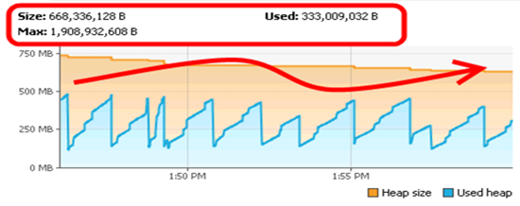
Garbage Collection and Finalizers
class A {
File tmpFile = createAndOpenTempFile();
...
public void finalize() { tmpFile.close(); }
}
...
while(true) { new A(); }
Finalizers are methods that are called when an object is reclaimed by the garbage collector
This code:
Is OK and a good use of finalizers
Runs out of memory because it is allocating many objects that are not garbage
Hits the max limit of open files
Notes:
c

Slide 63
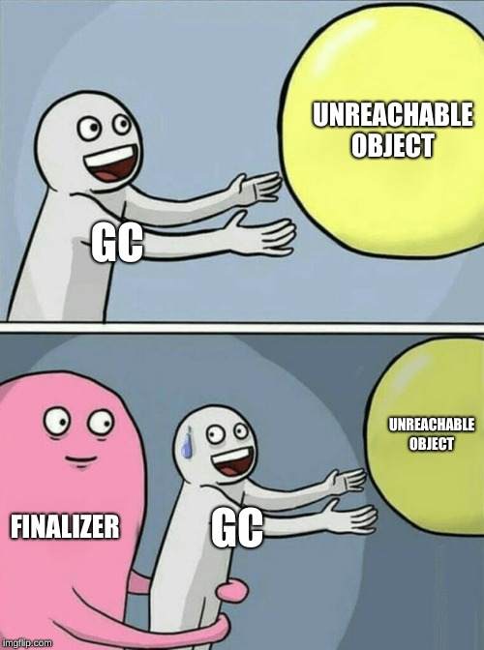
You Should not use Finalizers
You don’t have any guarantee that finalizers will ever run
Relying on them may cause your program to crash in weird and unexpected ways (e.g., see prev slide)
Finalizers are slow and inefficient
The code below is valid, which means that the GC cannot reclaim an object that has a finalizer on the current cycle
Needs to keep it around until the next GC cycle
class A {
static Object IDontLikeGC;
public void finalize() { A.IDontLikeGC = this; }
}

Slide 64
Java Weak/Soft References
import java.lang.ref.SoftReference;
import java.lang.ref.WeakReference;
Object o1 = new Object();
Object o2 = new Object();
WeakReference weak = new WeakReference<>(o1);
SoftReference soft = new SoftReference<>(o2);
o1.get(); // May be null
o2.get(); // May be null
Object only reachable through weak or soft references are considered garbage and can be collected
Weak References: Collected eagerly as soon as possible
Soft References: Left as floating garbage for as long as possible
Useful for implementing caches

Slide 65
Java Phantom References
Object o = new Object();
ReferenceQueue<Object> q;
q = new ReferenceQueue<>();
PhantomReference r;
r = new PhatomReference<>(o, q);
r.get(); // Always returns null
Finalizers done better
You get notified when a phantom reference is enqueued
You then must do the clean-up and then dequeue the object
Only then will the object be collected
No way to get the original reference back
If it is enqueued, you already lost all references

Slide 66
Notes:
Poll Title: Do not modify the notes in this section to avoid tampering with the Poll Everywhere activity. More info at polleverywhere.com/support Questions https://www.polleverywhere.com/discourses/p2pykZB7ifMumvCFR9ys1

Slide 67
Fragmentation
Before collection heap is full
Nursery
Heap
o1
o2
d
a
e
list
c
o3
x

Slide 68
Fragmentation
Before collection heap is full
Nursery
Heap
o1
o2
d
a
e
list
c
o3
x

Slide 69
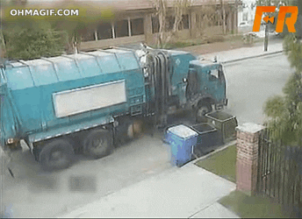
Fragmentation
Before collection heap is full
Nursery
Heap
o1
o2
d
a
e
list
o3

Slide 70
Fragmentation
Fragmentation leads to inneficient allocation
Nursery
Heap
o1
o2
d
a
e
list
Big Object
o3

Slide 71
Fragmentation
Fragmentation leads to inneficient allocation
Nursery
Heap
o1
o2
Big Object
d
a
e
list
o3

Slide 72
Fragmentation
Fragmentation leads to inneficient allocation
Nursery
Heap
o1
o2
Big Object
d
a
e
list
o3

Slide 73
Fragmentation
Fragmentation leads to inneficient allocation
Nursery
Heap
o1
o2
d
a
e
list
Big Object
o3

Slide 74
Fragmentation
Fragmentation leads to inneficient allocation
Fragmentation leads to memory waste
Nursery
Heap
o1
o2
d
a
e
list
Big Object
Bigger Object
o3

Slide 75
Fragmentation
What happens now?
Not enough memory, throw OutOfMemoryError
Split the bigger object in many small objects
Move other objects to make room
Nursery
Heap
o1
o2
d
a
e
list
Big Object
Bigger Object
o3
Notes:
c

Slide 76
Compacting
Nursery
Heap
o1
o2
d
a
e
list
Big Object
o3

Slide 77
Compacting
Nursery
Heap
Heap
o1
o2
d
a
e
list
o3

Slide 78
Compacting
Nursery
Heap
Nursery
Heap
Extra step after collection
Solves the fragmentation problem
o1
o1
o2
o2
d
e
a
list
d
o3
a
e
list
o3

Slide 79
Notes:
Poll Title: Do not modify the notes in this section to avoid tampering with the Poll Everywhere activity. More info at polleverywhere.com/support Questions https://www.polleverywhere.com/discourses/p2pykZB7ifMumvCFR9ys1

Slide 80
Compacting
Nursery
Heap
Nursery
Heap
Extra step after collection
Solves the fragmentation problem
o1
o1
o2
o2
d
e
a
list
d
o3
Can malloc compact the heap in C/C++?
Yes, just like in Java
Yes, but it’s very slow and nobody does it
No, it is impossible
a
e
list
o3
Notes:
c

Slide 81
Compacting
Can malloc compact the heap in C/C++?
No, it is impossible
After moving objects, the GC fixes all the references to those objects
In C/C++, we would have to fix all the pointers
Impossible to walk the heap in C/C++

Slide 82
Compacting
Nursery
Heap
Nursery
Heap
o1
o2
o1
o2
d
e
d
a
list
o3
a
e
list
o3

Slide 83
Bump-pointer
next-free-ptr
Keep a pointer to the start of the free space
Nursery
Heap
o1
o2
d
e
a
list
o3

Slide 84
Bump-pointer
next-free-ptr
Keep a pointer to the start of the free space
Allocate:
Put object on memory referred to by pointer
Nursery
Heap
o1
o2
d
e
a
list
o3
Big Object

Slide 85
Bump-pointer
next-free-ptr
Keep a pointer to the start of the free space
Allocate:
Put object on memory referred to by pointer
“Bump” the pointer to the end of the new object
Nursery
Heap
o1
o2
d
e
a
list
o3
Big Object

Slide 86
Bump-pointer
next-free-ptr
Keep a pointer to the start of the free space
Allocate:
Put object on memory referred to by pointer
“Bump” the pointer to the end of the new object
Nursery
Heap
o1
o2
d
e
a
list
o3
Big Object

Slide 87
Bump-pointer
next-free-ptr
Keep a pointer to the start of the free space
Allocate
Garbage Collect
When pointer goes over a threshold
AKA Water mark
Nursery
Heap
o1
o2
d
e
a
list
o3
Big Object

Slide 88
Bump-pointer
next-free-ptr
Keep a pointer to the start of the free space
Allocate
Garbage Collect
When pointer goes over a threshold
AKA Water mark
Nursery
Heap
o1
o2
d
e
a
list
o3
Big Object

Slide 89
Bump-pointer
next-free-ptr
Keep a pointer to the start of the free space
Allocate
Garbage Collect
When pointer goes over a threshold
AKA Water mark
Nursery
Heap
o1
o2
d
e
a
list
o3
Big Object

Slide 90
Bump pointer
Keep a pointer to the next free block
Allocate memory: advance the pointer
Free memory: reset the pointer
Old contents will be overwritten
Fast allocation
Compacting GC guarantees no fragmentation
Trigger GC when pointer above certain address
High-water mark

Slide 91
Notes:
Poll Title: Do not modify the notes in this section to avoid tampering with the Poll Everywhere activity. More info at polleverywhere.com/support Questions https://www.polleverywhere.com/discourses/p2pykZB7ifMumvCFR9ys1

Slide 92
Comparison
Reference Counting
No whole program pauses, more responsive programs
Simple implementation
Circular references lead to memory leaks
Tracing (e.g., mark-and-sweep)
Whole program pauses
Very short in practice
More complex implementation
Collects all non-reachable data, no mem leaks
Can compact memory, less fragmentation

Slide 93
Comparison
Reference counting
Short-lived programs
E.g., scripts
Restartable programs
Responsive programs
E.g., mobile apps
Tracing
Long-lived programs
Throughput vs latency
E.g., server software

Slide 94
Comparison
But the real world is weird
Java on smartphones
Android, tracing-gc
PHP on servers
Reference counting
Reference counting
Short-lived programs
E.g., scripts
Restartable programs
Responsive programs
E.g., mobile apps
Tracing
Long-lived programs
Throughput vs latency
E.g., server software

Slide 95
Garbage Collection
Tracing:
Java
C# / .NET
OCaml
Go
Reference counting:
C++ smart pointers
Rust alloc::rc
Perl
Python
PHP
Swift

Slide 96
Notes:
Poll Title: Do not modify the notes in this section to avoid tampering with the Poll Everywhere activity. More info at polleverywhere.com/support Questions https://www.polleverywhere.com/discourses/p2pykZB7ifMumvCFR9ys1

Slide 97
Copying Garbage Collector
Nursery
Used
Unused
d
a
e
list
c
x

Slide 98
Copying Garbage Collector
Nursery
Used
Unused
d
a
e
Found live object
list
c
x

Slide 99
Copying Garbage Collector
Nursery
Used
Unused
d
a
e
Copy it to the unused space
list
list
c
x

Slide 100
Copying Garbage Collector
Nursery
Used
Unused
d
list
a
e
Update reference
list
c
x

Slide 101
Copying Garbage Collector
Nursery
Used
Unused
d
list
a
e
Original object becomes forward reference
list
c
x

Slide 102
Copying Garbage Collector
Nursery
Used
Unused
d
list
a
e
Mark original object as moved
list
c
x

Slide 103
Copying Garbage Collector
Nursery
Used
Unused
d
list
d
a
e
a
e
Follow the transitive closure of all root references
list
c
x

Slide 104
Copying Garbage Collector
Nursery
Used
Unused
d
list
d
a
e
a
e
list
c
x

Slide 105
Copying Garbage Collector
Nursery
Used
Unused
d
list
d
a
e
a
e
How do we clear the used space?
Reclaim each object, one by one
Only reclaim the garbage, keep the survivors
Set the next pointer to the start, effectively reclaiming all objects
Switch spaces
list
c
x
Notes:
d

Slide 106
Copying Garbage Collector
Nursery
Used
Unused
d
list
d
a
e
a
e
list
c
x
Notes:
d

Slide 107
Copying Garbage Collector
Nursery
Unused
Used
list
d
a
e

Slide 108
Copying Garbage Collection
Two areas with same size (aka semi-spaces)
Only one used at any time
When GC’ing one, copy objects to the other
Then mark whole area as free
Pros
Fast, frequent GC cycles
Small semi-spaces
Fast allocation
Fast cleanup
Compacting “for free”
No need for extra step at the end of a GC cycle
Cons
Half the memory is wasted

Slide 109
Copying Garbage Collection
Two areas with same size
Only one used at any time
When GC’ing one, copy objects to the other
Then mark whole area as free
Pros
Fast, frequent GC cycles
Small semi-spaces
Fast allocation
Fast cleanup
Compacting “for free”
No need for extra step at the end of a GC cycle
Cons
Half the memory is wasted

Slide 110
Copying Garbage Collection
Two areas with same size
Only one used at any time
When GC’ing one, copy objects to the other
Then mark whole area as free
Pros
Fast, frequent GC cycles
Small semi-spaces
Fast allocation
Fast cleanup
Compacting “for free”
No need for extra step at the end of a GC cycle
Cons
Half the memory is wasted
Chrome’s Javascript engine V8 has a GC
Copying (aka scavenge) with semi-spaces is an important part of V8’s GC

Slide 111
Notes:
Poll Title: Do not modify the notes in this section to avoid tampering with the Poll Everywhere activity. More info at polleverywhere.com/support Questions https://www.polleverywhere.com/discourses/p2pykZB7ifMumvCFR9ys1

Slide 112
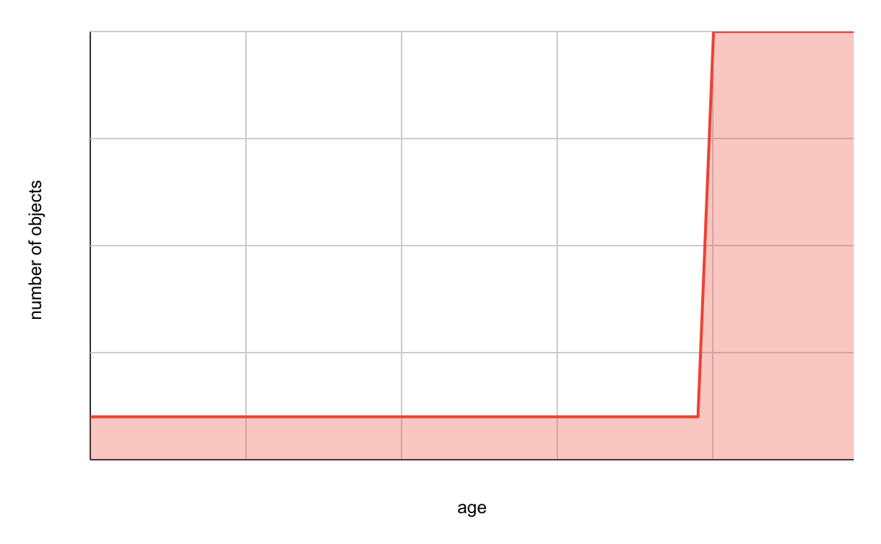
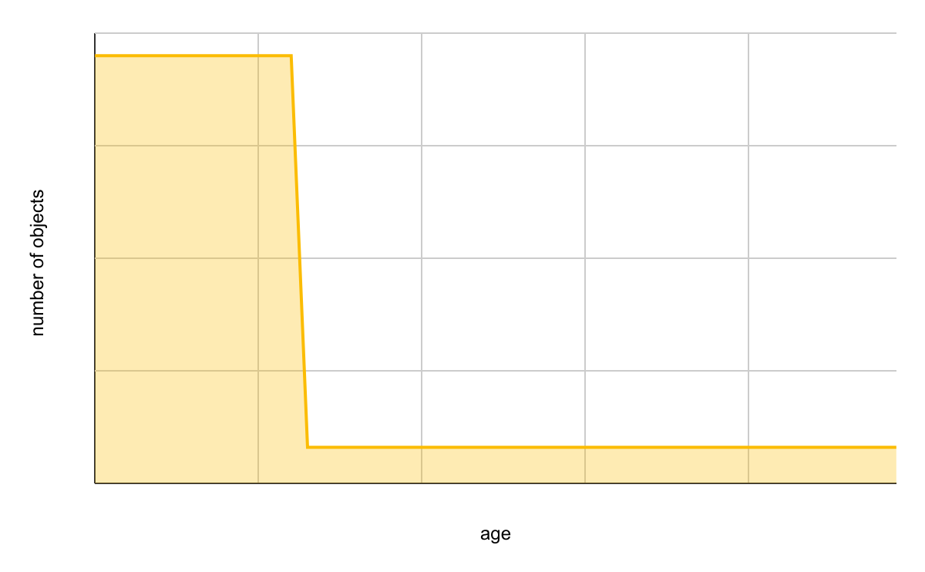
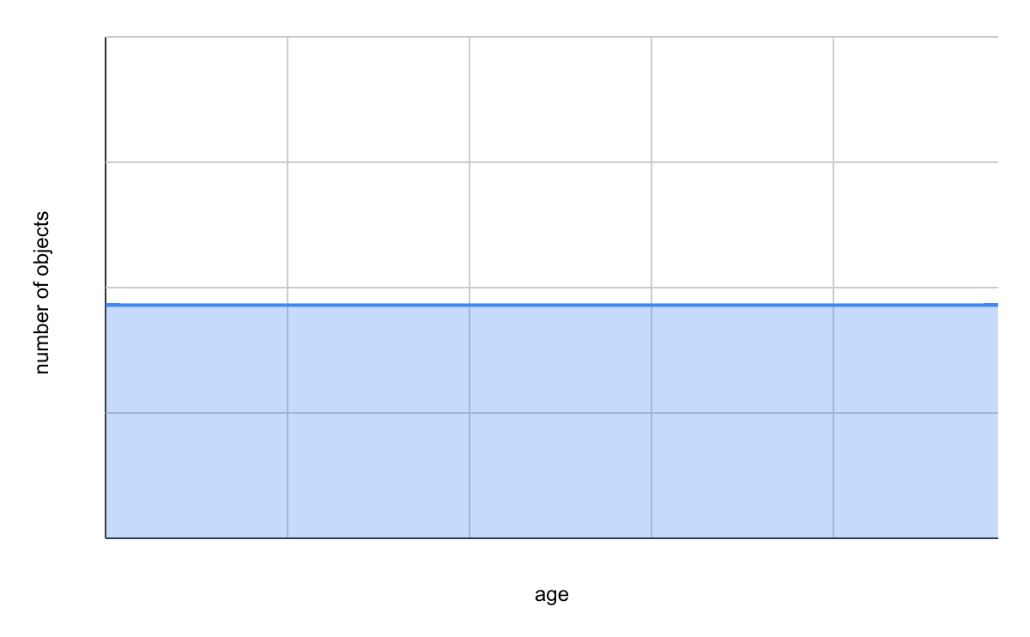
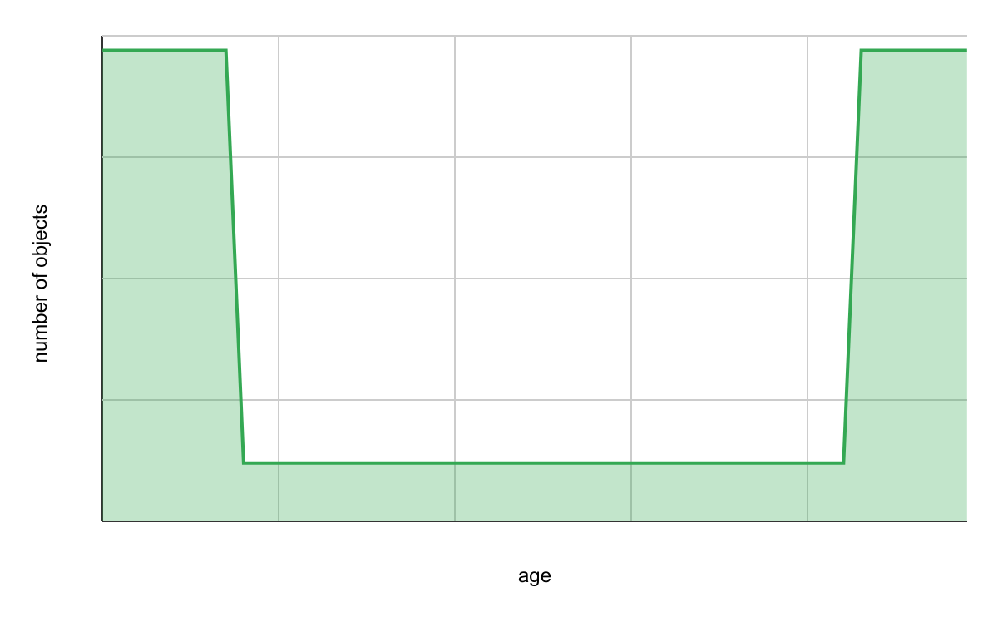
Lifetime of Objects
Which is more accurate?
Mostly old
Mostly new
Uniform
Bimodal
a)
b)
c)
d)

Slide 113
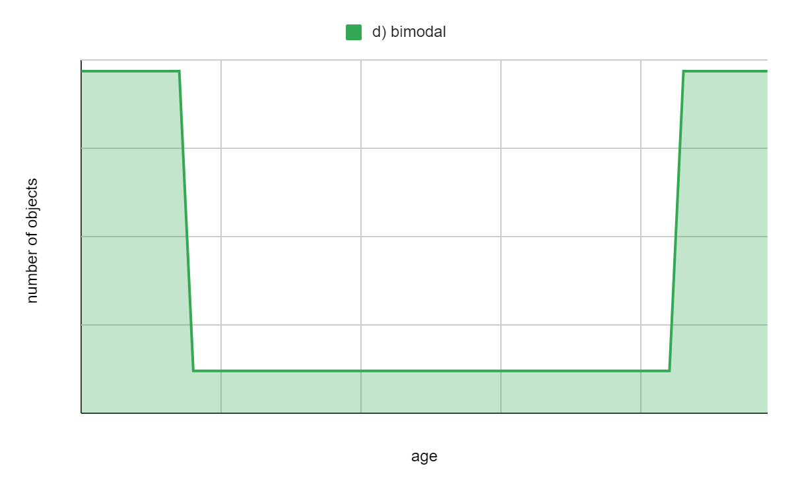
Generational Garbage Collection
Take advantage of the object lifetime distribution
Different lifetimes use different GC algorithms
Group objects by generation (age)

Slide 114
JVM generations
Nursery / Eden
Young objects
Garbage collected often
Quick GC’s, quick object allocation
Tenured space
Old objects that have survived a number of GCs
Garbage collected rarely
Slow GC
Survivors / Semi-spaces
In-between

Slide 115
Nursery (aka eden)
Copying GC algorithm
Surviving objects are moved elsewhere
Bump-pointer allocation
Allocating new objects is just incrementing a pointer
Each GC cycle results in an empty nursery
Surviving objects were moved
Other objects are reclaimed
Nursery

Slide 116
Nursery (aka eden)
Copying GC algorithm
Surviving objects are moved elsewhere
Bump-pointer allocation
Allocating new objects is just incrementing a pointer
Each GC cycle results in an empty nursery
Surviving objects were moved
Other objects are reclaimed
Nursery

Slide 117
Semi-spaces
Copying GC algorithm
Surviving objects are moved to the other semi-space
Few objects survive the nursery
After surviving N generations, they are promoted
Nursery
Survivor 1
Survivor 2

Slide 118
Semi-spaces
Copying GC algorithm
Surviving objects are moved to the other semi-space
Few objects survive the nursery
After surviving N generations, they are promoted
Nursery
Survivor 1
Survivor 2

Slide 119
Semi-spaces
Copying GC algorithm
Surviving objects are moved to the other semi-space
Few objects survive the nursery
After surviving N generations, they are promoted
Nursery
Survivor 1
Survivor 2

Slide 120
Semi-spaces
Copying GC algorithm
Surviving objects are moved to the other semi-space
Few objects survive the nursery
After surviving N generations, they are promoted
Nursery
Survivor 1
Survivor 2

Slide 121
Semi-spaces
Copying GC algorithm
Surviving objects are moved to the other semi-space
Few objects survive the nursery
After surviving N generations, they are promoted
Nursery
Survivor 1
Survivor 2

Slide 122
Tenured Space
Last generation
Only for long-lived objects
GC’ed very infrequently
Very expensive
Mark-and-sweep
Maybe compact afterwards
Full GC means GC all generations
Most GCs only touch nursery
Some GCs touch semi-spaces
Almost no GCs touch tenured space
Nursery
Survivor 1
Survivor 2
Tenured

Slide 123
Tenured Space
Last generation
Only for long-lived objects
GC’ed very infrequently
Very expensive
Mark-and-sweep
Maybe compact afterwards
Full GC means GC all generations
Most GCs only touch nursery
Some GCs touch semi-spaces
Almost no GCs touch tenured space
Nursery
Survivor 1
Survivor 2
Tenured

Slide 124
Tenured Space
Last generation
Only for long-lived objects
GC’ed very infrequently
Very expensive
Mark-and-sweep
Maybe compact afterwards
Full GC means GC all generations
Most GCs only touch nursery
Some GCs touch semi-spaces
Almost no GCs touch tenured space
Nursery
Survivor 1
Survivor 2
Tenured

Slide 125
Tenured Space
Last generation
Only for long-lived objects
GC’ed very infrequently
Very expensive
Mark-and-sweep
Maybe compact afterwards
Full GC means GC all generations
Most GCs only touch nursery
Some GCs touch semi-spaces
Almost no GCs touch tenured space
Nursery
Survivor 1
Survivor 2
Tenured

Slide 126
Tenured Space
Last generation
Only for long-lived objects
GC’ed very infrequently
Very expensive
Mark-and-sweep
Maybe compact afterwards
Full GC means GC all generations
Most GCs only touch nursery
Some GCs touch semi-spaces
Almost no GCs touch tenured space
Nursery
Survivor 1
Survivor 2
Tenured

Slide 127
Tenured Space
Last generation
Only for long-lived objects
GC’ed very infrequently
Very expensive
Mark-and-sweep
Maybe compact afterwards
Full GC means GC all generations
Most GCs only touch nursery
Some GCs touch semi-spaces
Almost no GCs touch tenured space
Nursery
Survivor 1
Survivor 2
Tenured

Slide 128
Tenured Space
Last generation
Only for long-lived objects
GC’ed very infrequently
Very expensive
Mark-and-sweep
Maybe compact afterwards
Full GC means GC all generations
Most GCs only touch nursery
Some GCs touch semi-spaces
Almost no GCs touch tenured space
Nursery
Survivor 1
Survivor 2
Tenured

Slide 129
Permanent Generation (PermGen)
Special generation
Never garbage-collected
Contains entities with static lifetime
E.g., loaded classes, constants, meta-data, etc.
Nursery
Survivor 1
Survivor 2
Tenured
PermGen

Slide 130
GC frequency
Nursery
Bump pointer
Empty after each collection
Very frequent
Very Fast
Survivor 1
Copying
Frequent, fast
Survivor 2
Rare, slow
Tenured
Mark-sweep + Compact
PermGen
Out of space?
java.lang.OutOfMemoryError: PermGen space
Never

Slide 131
GC frequency
Nursery
Very frequent
Very Fast
Full GC
Survivor 1
Frequent, fast
Survivor 2
Rare, slow
Tenured
PermGen
Never

Slide 132
GC frequency
Nursery
java.lang.Runtime.gc();
Very frequent
Very Fast
Full GC
Survivor 1
Frequent, fast
Survivor 2
Rare, slow
Tenured
PermGen
Never

Slide 133
GC frequency
Nursery
java.lang.Runtime.gc();
Very frequent
Very Fast
Full GC
Survivor 1
Frequent, fast
Survivor 2
Rare, slow
Tenured
PermGen
Never

Slide 134
Notes:
Poll Title: Do not modify the notes in this section to avoid tampering with the Poll Everywhere activity. More info at polleverywhere.com/support Questions https://www.polleverywhere.com/discourses/p2pykZB7ifMumvCFR9ys1

Slide 135
VisualVM / VisualGC demo
java -XX:+UseConcMarkSweepGC -Xmx256M -Xms256M GC
java -XX:+UseG1GC -Xmx8G -jar release/sunflow.jar -nogui -o result.png -aa 4 8 examples/wireframe_demo.java

Slide 136
Garbage-First (G1) Collector
Introduced in Java 7, made default in Java 8
High-throughput
Low latency
GC performed in smaller increments
User can set a maximum GC pause
Soft limit, G1 will try to stay under but may fail
Highly parallel
Uses multiple threads to collect garbage

Slide 137
G1 Collector Heap
Regular Generation GC:
Garbage-First (G1):

Slide 138
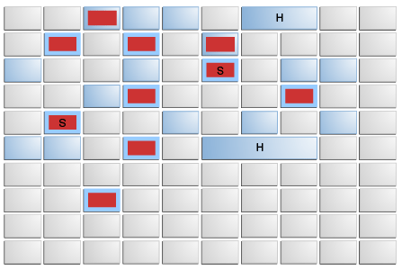
G1 Collector Heap
Humongous Objects
Young generation
Old generation
Survivor generation
Free space

Slide 139
Notes:
Poll Title: Do not modify the notes in this section to avoid tampering with the Poll Everywhere activity. More info at polleverywhere.com/support Questions https://www.polleverywhere.com/discourses/p2pykZB7ifMumvCFR9ys1

