Slide 1
CS474
Object-Oriented Languages and Environments
Spring 2023
Instructor: William Mansky
Lecture 12: Just-In-Time Compilation

Slide 2
Notes:
Poll Title: Do not modify the notes in this section to avoid tampering with the Poll Everywhere activity. More info at polleverywhere.com/support Questions https://www.polleverywhere.com/discourses/p2pykZB7ifMumvCFR9ys1

Slide 3
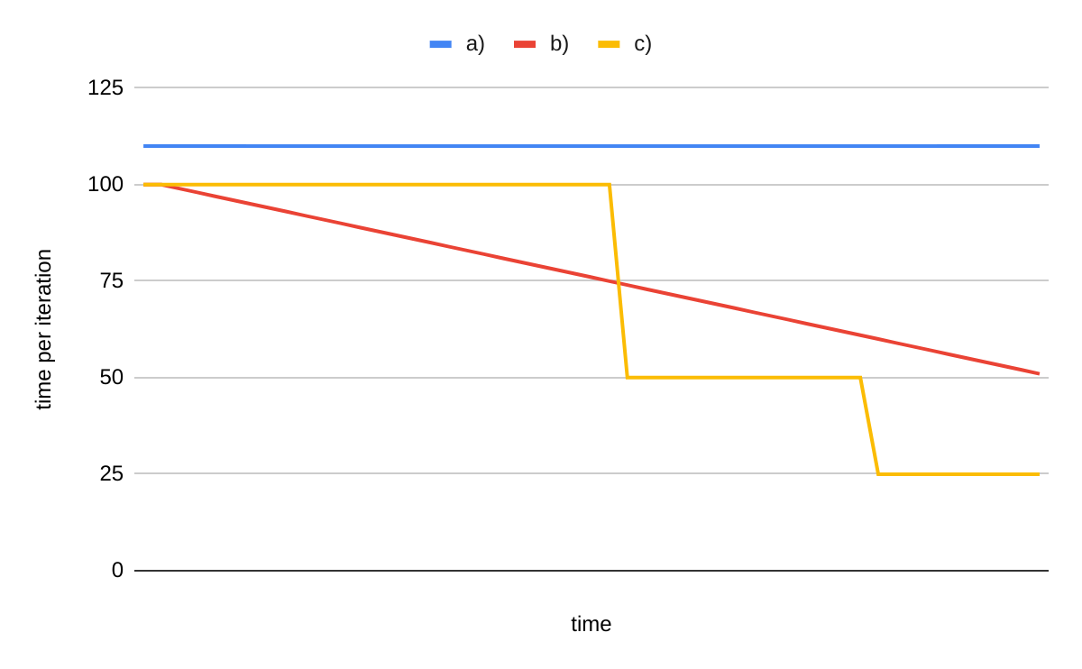
Executing Java code
What does the running time per call to max look like?
void max(List<C> cs) {
if (cs.length == 0)
System.out.println("Empty List");
C max = null;
for(C c : cs) {
if (max == null)
max = c;
else if (c.getField() > max.getField())
max = c;
}
System.out.println(max.toString());
}
Notes:
10000 100

Slide 4
Executing Java Code
The JVM uses an interpreter to start executing the bytecode
The JVM also uses a just-in-time compiler to turn the bytecode into (fast) native code
When to stop interpreting and start compiling?

Slide 5
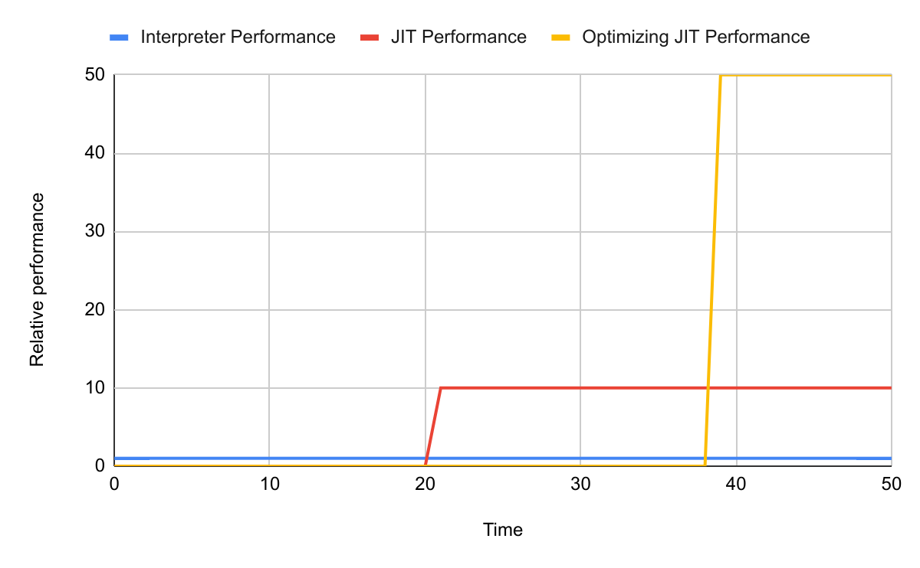
Interpreting vs Compiling
Notes:
The interpreter isn’t fast, but starts immediately. The compiler takes some time to get performant code; the optimizing compiler takes longer for more performant code.

Slide 6
Interpreting vs Compiling
What would you do?
Use the interpreter to get something running
Use the compiler and wait for the results, but then it’s fast
Use the optimizing compiler, it will pay off in the future

Slide 7
JVM example
Run code
-XX:-BackgroundCompilation -XX:+UnlockDiagnosticVMOptions

Slide 8
Notes:
Poll Title: Do not modify the notes in this section to avoid tampering with the Poll Everywhere activity. More info at polleverywhere.com/support Questions https://www.polleverywhere.com/discourses/p2pykZB7ifMumvCFR9ys1

Slide 9
How the JVM does it
class C {
private int field;
public int getField() {
return field;
}
public String toString() {
return "Field: " + field;
}
}
void max(List<C> cs) {
if (cs.length == 0)
System.out.println("Empty List");
C max = null;
Iterator<C> i = l.iter();
while (i.hasNext()) {
C c = i.next();
if (max == null)
max = c;
else if (c.getField() > max.getField())
max = c;
}
System.out.println(max.toString());
}
The program keeps calling max many times
Which method is most worth compiling?
System.out.println
C.getField
C.toString
List.iter

Slide 10
How the JVM does it
class C {
private int field;
public int getField() {
return field;
}
public String toString() {
return "Field: " + field;
}
}
void max(List<C> cs) {
if (cs.length == 0)
System.out.println("Empty List");
C max = null;
Iterator<C> i = l.iter();
while (i.hasNext()) {
C c = i.next();
if (max == null)
max = c;
else if (c.getField() > max.getField())
max = c;
}
System.out.println(max.toString());
}
The program keeps calling max many times
1st call, 1st iteration

Slide 11
How the JVM does it
class C {
private int field;
public int getField() {
return field;
}
public String toString() {
return "Field: " + field;
}
}
void max(List<C> cs) {
if (cs.length == 0)
System.out.println("Empty List");
C max = null;
Iterator<C> i = l.iter();
while (i.hasNext()) {
C c = i.next();
if (max == null)
max = c;
else if (c.getField() > max.getField())
max = c;
}
System.out.println(max.toString());
}
The program keeps calling max many times
1st call
1st iteration
1000th iteration

Slide 12
How the JVM does it
class C {
private int field;
public int getField() {
return field;
}
public String toString() {
return "Field: " + field;
}
}
void max(List<C> cs) {
if (cs.length == 0)
System.out.println("Empty List");
C max = null;
Iterator<C> i = l.iter();
while (i.hasNext()) {
C c = i.next();
if (max == null)
max = c;
else if (c.getField() > max.getField())
max = c;
}
System.out.println(max.toString());
}
The program keeps calling max many times
1st call
1st iteration
1000th iteration
1000th call

Slide 13
How the JVM does it
class C {
private int field;
public int getField() {
return field;
}
public String toString() {
return "Field: " + field;
}
}
void max(List<C> cs) {
if (cs.length == 0)
System.out.println("Empty List");
C max = null;
Iterator<C> i = l.iter();
while (i.hasNext()) {
C c = i.next();
if (max == null)
max = c;
else if (c.getField() > max.getField())
max = c;
}
System.out.println(max.toString());
}
The program keeps calling max many times
1st call
1st iteration
1000th iteration
1000th call
Which method is most worth compiling?
System.out.println
C.getField
C.toString
List.iter
Notes:
b

Slide 14
Just-In-Time Compiling
Start executing the bytecode using the interpreter
Fast program startup
Get profiling information to detect compilation candidates
After a short while, use a simple compiler for the hot code
Keep profiling
After another short while, use an optimizing compiler for the hottest code
Now we know it is worth it

Slide 15
Notes:
Poll Title: Do not modify the notes in this section to avoid tampering with the Poll Everywhere activity. More info at polleverywhere.com/support Questions https://www.polleverywhere.com/discourses/p2pykZB7ifMumvCFR9ys1

Slide 16
Simple Compiler
Idea: Just translate to machine code, as fast as possible
Direct translation of bytecode to machine code
Replace bytecode instructions by machine instructions
No need for the operand stack anymore
Figure out if all the locals fit in the registers
Figure out if some stack positions need to fit in the registers
Do register allocation

Slide 17
Optimizing Compiler
Take some time doing some optimizations
Method inlining
Monomorphization
Escape analysis
Loop unrolling
Code motion
(and more)
Most performance gain, less time to optimize
Less performance gain, more time to optimize

Slide 18
Inlining getField
class C {
private int field;
public int getField() {
return field;
}
public String toString() {
return "Field: " + field;
}
}
void max(List<C> cs) {
if (cs.length == 0)
System.out.println("Empty List");
C max = null;
Iterator<C> i = l.iter();
while (i.hasNext()) {
C c = i.next();
if (max == null)
max = c;
else if (c.getField() > max.getField())
max = c;
}
System.out.println(max.toString());
}
Notes:
b

Slide 19
Inlining getField
class C {
private int field;
public int getField() {
return field;
}
public String toString() {
return "Field: " + field;
}
}
void max(List<C> cs) {
if (cs.length == 0)
System.out.println("Empty List");
C max = null;
Iterator<C> i = l.iter();
while (i.hasNext()) {
C c = i.next();
if (max == null)
max = c;
else if (c.field > max.field)
max = c;
}
System.out.println(max.toString());
}

Slide 20
Method inlining
Inlining is great for small methods
Cost of method call is huge, in comparison to method body
Enables other optimizations
Inlining is not great for large methods
Cost of method call is small, in comparison to method body
Huge methods have poor code-cache locality
There’s so much code, it does not fit in the code cache
Poorer performance

Slide 21
Method inlining
-XX:+Inline
Enables method inlining. This option is enabled by default to increase performance. To disable method inlining,
specify -XX:-Inline.
-XX:InlineSmallCode=size
Sets the maximum code size (in bytes) for compiled methods that should be inlined. Append the letter k or K to
indicate kilobytes, m or M to indicate megabytes, g or G to indicate gigabytes. Only compiled methods with the size
smaller than the specified size will be inlined. By default, the maximum code size is set to 1000 bytes:
-XX:InlineSmallCode=1000
-XX:MaxInlineSize=size
Sets the maximum bytecode size (in bytes) of a method to be inlined. Append the letter k or K to indicate kilobytes,
m or M to indicate megabytes, g or G to indicate gigabytes. By default, the maximum bytecode size is set to 35 bytes:
-XX:MaxInlineSize=35

Slide 22
Notes:
Poll Title: Do not modify the notes in this section to avoid tampering with the Poll Everywhere activity. More info at polleverywhere.com/support Questions https://www.polleverywhere.com/discourses/p2pykZB7ifMumvCFR9ys1

Slide 23
Inlining getField
class C {
private int field;
public int getField() {
return field;
}
public String toString() {
return "Field: " + field;
}
}
void max(List<C> cs) {
if (cs.length == 0)
System.out.println("Empty List");
C max = null;
Iterator<C> i = l.iter();
while (i.hasNext()) {
C c = i.next();
if (max == null)
max = c;
else if (c.field > max.field)
max = c;
}
System.out.println(max.toString());
}
Can all methods be inlined?
Yes, always
Yes, but sometimes does not make sense
Some methods cannot ever be inlined
Notes:
c

Slide 24
Inlining recursive methods
Recursive methods cannot be inlined
Each call needs a separate stack frame
Inlining uses a single stack frame
int fact(int x) {
if (x == 1)
return 1;
else
return x * fact(x-1);
}
Notes:
c

Slide 25
Inlining recursive methods
Recursive methods cannot be inlined
Each call needs a separate stack frame
Inlining uses a single stack frame
int fact(int x) {
if (x == 1)
return 1;
else
return x * fact(x-1);
}
Notes:
c

Slide 26
Notes:
Poll Title: Do not modify the notes in this section to avoid tampering with the Poll Everywhere activity. More info at polleverywhere.com/support Questions https://www.polleverywhere.com/discourses/p2pykZB7ifMumvCFR9ys1

Slide 27
Optimizing Compiler
Take some time doing some optimizations
Method inlining
Monomorphization
Escape analysis
Loop unrolling
Code motion
(and more)
Most performance gain, less time to optimize
Less performance gain, more time to optimize

Slide 28
Inlining getField
class C {
private int field;
public int getField() {
return field;
}
public String toString() {
return "Field: " + field;
}
}
void max(List<C> cs) {
if (cs.length == 0)
System.out.println("Empty List");
C max = null;
Iterator<C> i = l.iter();
while (i.hasNext()) {
C c = i.next();
if (max == null)
max = c;
else if (c.field > max.field)
max = c;
}
System.out.println(max.toString());
}
How else might this go wrong?
Notes:
b

Slide 29
Inlining getField
class C {
private int field;
public int getField() {
return field;
}
public String toString() {
return "Field: " + field;
}
}
void max(List<C> cs) {
if (cs.length == 0)
System.out.println("Empty List");
C max = null;
Iterator<C> i = l.iter();
while (i.hasNext()) {
C c = i.next();
if (max == null)
max = c;
else if (c.field > max.field)
max = c;
}
System.out.println(max.toString());
}
class D extends C {
public int getField() {
return 10;
}
}
Notes:
a

Slide 30
Monomorphization
Safely turning a polymorphic (dynamically dispatched) call into a monomorphic (statically dispatched) call
Monomorphic call can then be inlined
Notes:
i and ii

Slide 31
Monomorphization
class C {
private int field;
public int getField() {
return field;
}
public String toString() {
return "Field: " + field;
}
}
void max(List<C> cs) {
if (cs.length == 0)
System.out.println("Empty List");
C max = null;
Iterator<C> i = l.iter();
while (i.hasNext()) {
C c = i.next();
if (!(c instance C)) // do virtual call through vtable
if (max == null)
max = c;
else if (c.field > max.field)
max = c;
}
System.out.println(max.toString());
}
Checking the class of an instance is very cheap
The JVM includes 2 slots for monomorphization
It can inline virtual calls that go up to 2 different methods
More than that, we need to use the vtable
Also works for interfaces

Slide 32
Checking the class
Checking the class of an instance takes one memory read
Check if the metadata points to the known class vtable
Very fast, this is typically in the CPU cache
A a = new A();
metadata
class A {
int field1;
void m1() { }
void m2() { }
}
metadata
field1

Slide 33
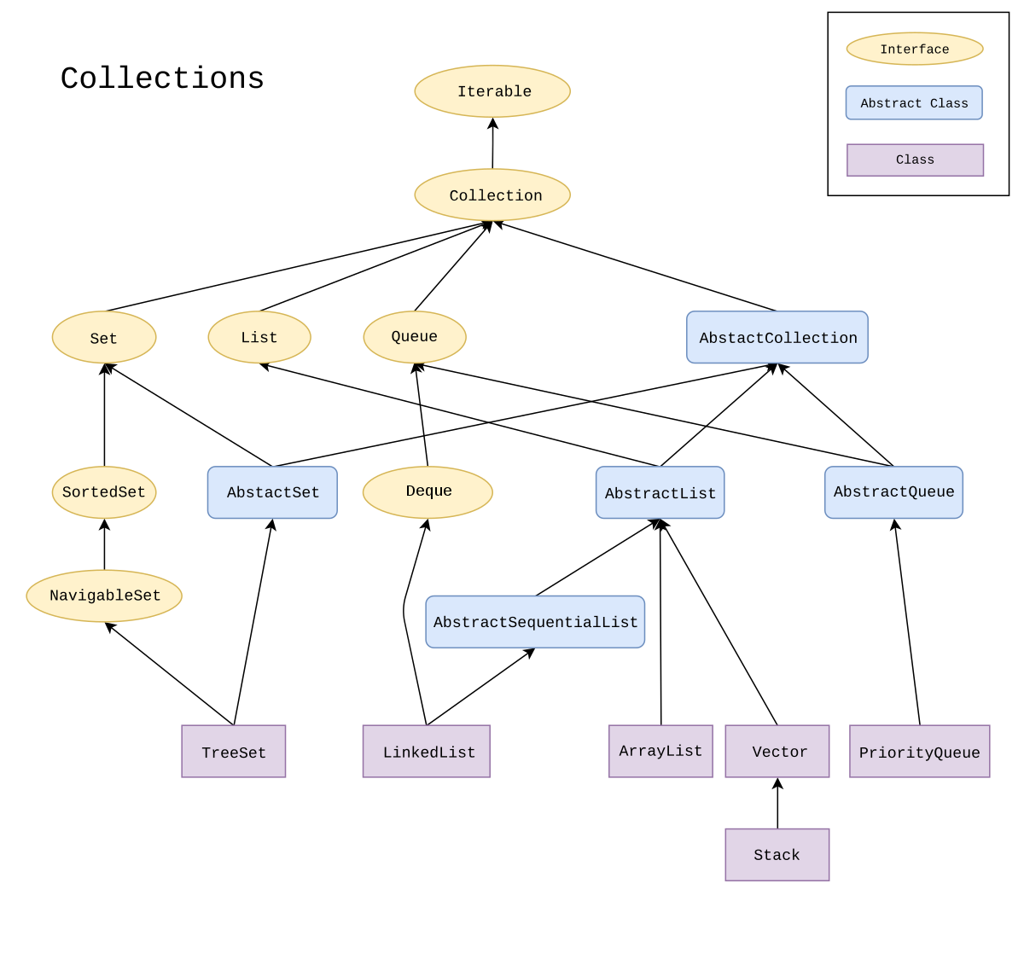
Big difference between Java and C++
void m(Collection<String> c, Object o) {
if (!c.isEmpty() && c.get(0).equals(o))
...
}
Collection is an interface
At compile-time, we don’t know the type of c
We need to use the itable (slow)
C++ and Java interpreter

Slide 34
Big difference between Java and C++
void m(Collection<String> c, Object o) {
if (!c.isEmpty() && c.get(0).equals(o))
...
}
During execution, Java realizes that c is either a LinkedList or an ArrayList
For this particular program
For this particular execution
Monomorphization and inlining leads to fast code
Java JIT

Slide 35
Big difference between Java and C++
Methods in C++ are non-virtual (can’t be overriden) by default
Java calls non-virtual methods final
Developers have to figure out where to use dynamic dispatch because it is slow
Method in Java are virtual by default
C++ has a virtual keyword, Java does not
Developers don’t really have to think about dynamic dispatch vs performance

Slide 36
Methods: Static, private, virtual, interfaces
interface I1 { void m1(); }
class A {
void ma() { }
}
class B extends A implements I1 {
void m1() { }
void ma() { }
void mb() { }
private void mp() { }
public static void ms() { }
}
Which is faster?
B.ms()
new B().mp()
new B().ma()
new B().mb()
new B().m1()
Notes:
A or b

Slide 37
Methods: Static, private, virtual, interfaces
interface I1 { void m1(); }
class A {
void ma() { }
}
class B extends A implements I1 {
void m1() { }
void ma() { }
void mb() { }
private void mp() { }
public static void ms() { }
}
Which is faster?
B.ms()
new B().mp()
new B().ma()
new B().mb()
new B().m1()
In practice all these can be optimized to be as fast as mp or ms (most of the times)
Notes:
A or b

Slide 38
Notes:
Poll Title: Do not modify the notes in this section to avoid tampering with the Poll Everywhere activity. More info at polleverywhere.com/support Questions https://www.polleverywhere.com/discourses/p2pykZB7ifMumvCFR9ys1

Slide 39
Optimizing Compiler
Take some time doing some optimizations
Method inlining
Monomorphization
Escape analysis
Loop unrolling
Code mobility
(and more)
Most performance gain, less time to optimize
Less performance gain, more time to optimize

Slide 40
Escape Analysis
class C {
private int field;
public int getField() {
return field;
}
public String toString() {
return "Field: " + field;
}
}
void max(List<C> cs) {
if (cs.length == 0)
System.out.println("Empty List");
C max = null;
Iterator<C> i = l.iter();
while (i.hasNext()) {
C c = i.next();
if (!(c instance C)) // do virtual call through vtable
if (max == null)
max = c;
else if (c.field > max.field)
max = c;
}
System.out.println(max.toString());
}
Do we need to create an Iterator instance to run this?
Yes
No
Notes:
b

Slide 41
Escape Analysis
void max(List<C> cs) {
if (cs.length == 0)
System.out.println("Empty List");
C max = null;
Iterator<C> i = l.iter();
while (i.hasNext()) {
C c = i.next();
if (!(c instance C)) // use vtable
if (max == null)
max = c;
else if (c.field > max.field)
max = c;
}
System.out.println(max.toString());
}
class ListIterator<T> implements Iterator<T> {
private Node<T> currentNode;
...
}
The iterator never escapes the method!
Check if instances escape the method
If not, replace instances by their fields and inline code

Slide 42
Escape Analysis
void max(List<C> cs) {
if (cs.length == 0)
System.out.println("Empty List");
C max = null;
Node<C> i = // inline l.iter();
while (/* inline i.hasNext() */) {
C c = /* inline i.next() */;
if (!(c instance C)) // use vtable
if (max == null)
max = c;
else if (c.field > max.field)
max = c;
}
System.out.println(max.toString());
}
class ListIterator<T> implements Iterator<T> {
private Node<T> currentNode;
...
}
The iterator never escapes the method!
Check if instances escape the method
If not, replace instances by their fields and inline code

Slide 43
Notes:
Poll Title: Do not modify the notes in this section to avoid tampering with the Poll Everywhere activity. More info at polleverywhere.com/support Questions https://www.polleverywhere.com/discourses/p2pykZB7ifMumvCFR9ys1

Slide 44
Optimizing Compiler
Take some time doing some optimizations
Method inlining
Monomorphization
Escape analysis
Loop unrolling
Code motion
(and more)
Most performance gain, less time to optimize
Less performance gain, more time to optimize

Slide 45
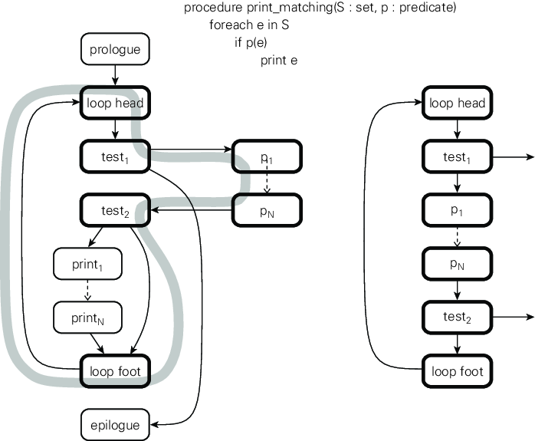
Code motion
Looping to find instance to print
The test highlighted is almost always false
Straight-line code executes faster than branching code
Better use of the code cache

Slide 46
Code motion
Move instructions around to generate the most straight-line code possible

Slide 47
Loops
Which is faster?
a) b)
sum += A[0]; squares += A[0] * A[0];
sum += A[1]; squares += A[1] * A[1];
sum += A[2]; squares += A[2] * A[2];
sum += A[3]; squares += A[3] * A[3];
sum += A[4]; squares += A[4] * A[4];
sum += A[5]; squares += A[5] * A[5];
sum += A[6]; squares += A[6] * A[6];
sum += A[7]; squares += A[7] * A[7];
sum += A[8]; squares += A[8] * A[8];
sum += A[9]; squares += A[9] * A[9];
i = 0;
do {
sum += A[i]; squares += A[i] * A[i]; i++;
} while (i < 10);
Notes:
b

Slide 48
Loops
Which is faster?
a) b)
sum += A[0]; squares += A[0] * A[0];
sum += A[1]; squares += A[1] * A[1];
sum += A[2]; squares += A[2] * A[2];
sum += A[3]; squares += A[3] * A[3];
sum += A[4]; squares += A[4] * A[4];
sum += A[5]; squares += A[5] * A[5];
sum += A[6]; squares += A[6] * A[6];
sum += A[7]; squares += A[7] * A[7];
sum += A[8]; squares += A[8] * A[8];
sum += A[9]; squares += A[9] * A[9];
sum += A[i]; squares += A[i] * A[i]; i++; if (i<10)
sum += A[i]; squares += A[i] * A[i]; i++; if (i<10)
sum += A[i]; squares += A[i] * A[i]; i++; if (i<10)
sum += A[i]; squares += A[i] * A[i]; i++; if (i<10)
sum += A[i]; squares += A[i] * A[i]; i++; if (i<10)
sum += A[i]; squares += A[i] * A[i]; i++; if (i<10)
sum += A[i]; squares += A[i] * A[i]; i++; if (i<10)
sum += A[i]; squares += A[i] * A[i]; i++; if (i<10)
sum += A[i]; squares += A[i] * A[i]; i++; if (i<10)
sum += A[i]; squares += A[i] * A[i]; i++; if (i<10)

Slide 49
Loops
Loop book-keeping overhead is especially high for small loop bodies
Unrolled loop has less work to do, is faster
Which is faster?
a) b)
sum += A[0]; squares += A[0] * A[0];
sum += A[1]; squares += A[1] * A[1];
sum += A[2]; squares += A[2] * A[2];
sum += A[3]; squares += A[3] * A[3];
sum += A[4]; squares += A[4] * A[4];
sum += A[5]; squares += A[5] * A[5];
sum += A[6]; squares += A[6] * A[6];
sum += A[7]; squares += A[7] * A[7];
sum += A[8]; squares += A[8] * A[8];
sum += A[9]; squares += A[9] * A[9];
sum += A[i]; squares += A[i] * A[i]; i++; if (i<10)
sum += A[i]; squares += A[i] * A[i]; i++; if (i<10)
sum += A[i]; squares += A[i] * A[i]; i++; if (i<10)
sum += A[i]; squares += A[i] * A[i]; i++; if (i<10)
sum += A[i]; squares += A[i] * A[i]; i++; if (i<10)
sum += A[i]; squares += A[i] * A[i]; i++; if (i<10)
sum += A[i]; squares += A[i] * A[i]; i++; if (i<10)
sum += A[i]; squares += A[i] * A[i]; i++; if (i<10)
sum += A[i]; squares += A[i] * A[i]; i++; if (i<10)
sum += A[i]; squares += A[i] * A[i]; i++; if (i<10)

Slide 50
Loop Unrolling
i = 0;
do {
sum += A[i]; squares += A[i] * A[i]; i++;
} while (i < 10);
i = 0; j = N/4;
do {
sum += A[i+0]; squares += A[i+0] * A[i+0];
sum += A[i+1]; squares += A[i+1] * A[i+1];
sum += A[i+2]; squares += A[i+2] * A[i+2];
sum += A[i+3]; squares += A[i+3] * A[i+3];
i += 4;
} while (--j > 0);
do {
sum += A[i]; squares += A[i] * A[i]; i++;
} while (i < N);
Go in steps of 4
Finish up (non-multiples of 4)

Slide 51
Loop Unrolling – Duff’s Device
i = 0;
do {
sum += A[i]; squares += A[i] * A[i]; i++;
} while (i < 10);
i = 0; j = N/4;
do {
sum += A[i+0]; squares += A[i+0] * A[i+0];
sum += A[i+1]; squares += A[i+1] * A[i+1];
sum += A[i+2]; squares += A[i+2] * A[i+2];
sum += A[i+3]; squares += A[i+3] * A[i+3];
i += 4;
} while (--j > 0);
do {
sum += A[i]; squares += A[i] * A[i]; i++;
} while (i < N);
Go in steps of 4
Finish up (non-multiples of 4)
i = 0; j = (N+3)/4;
do{
switch (N%4) {
case 0: sum += A[i]; squares += A[i] * A[i]; i++;
case 3: sum += A[i]; squares += A[i] * A[i]; i++;
case 2: sum += A[i]; squares += A[i] * A[i]; i++;
case 1: sum += A[i]; squares += A[i] * A[i]; i++;
}
} while (--j > 0);
Go in steps of 4
No need to finish up!

Slide 52
Loop Unrolling – Duff’s Device
i = 0; j = (N+3)/4;
do{
switch (N%4) {
case 0: sum += A[i]; squares += A[i] * A[i]; i++;
case 3: sum += A[i]; squares += A[i] * A[i]; i++;
case 2: sum += A[i]; squares += A[i] * A[i]; i++;
case 1: sum += A[i]; squares += A[i] * A[i]; i++;
}
} while (--j > 0);
Go in steps of 4
No need to finish up!

Slide 53
Notes:
Poll Title: Do not modify the notes in this section to avoid tampering with the Poll Everywhere activity. More info at polleverywhere.com/support Questions https://www.polleverywhere.com/discourses/p2pykZB7ifMumvCFR9ys1

Slide 54
Optimizing Compiler
Take some time doing some optimizations
Method inlining
Monomorphization
Escape analysis
Loop unrolling
Code mobility
(and more)
Most performance gain, less time to optimize
Less performance gain, more time to optimize

Slide 55
JIT Compilation
What is this phone doing?
while (true) sleep(10);
Decompressing apps
Compiling apps to bytecode
Compiling apps to native code
Notes:
d

Slide 56
Ahead-of-time Compilation (AOT)
Startup time of Android apps is important
JIT compiling code is wasting battery
Android 5 (Lollipop) introduced AOT
Before, Android used the Dalvik VM which is JIT’ed
Now Android uses the Android Runtime (ART), which is compiled ahead-of-time
Not sure how they get the code profiling to decide what to optimize

Slide 57
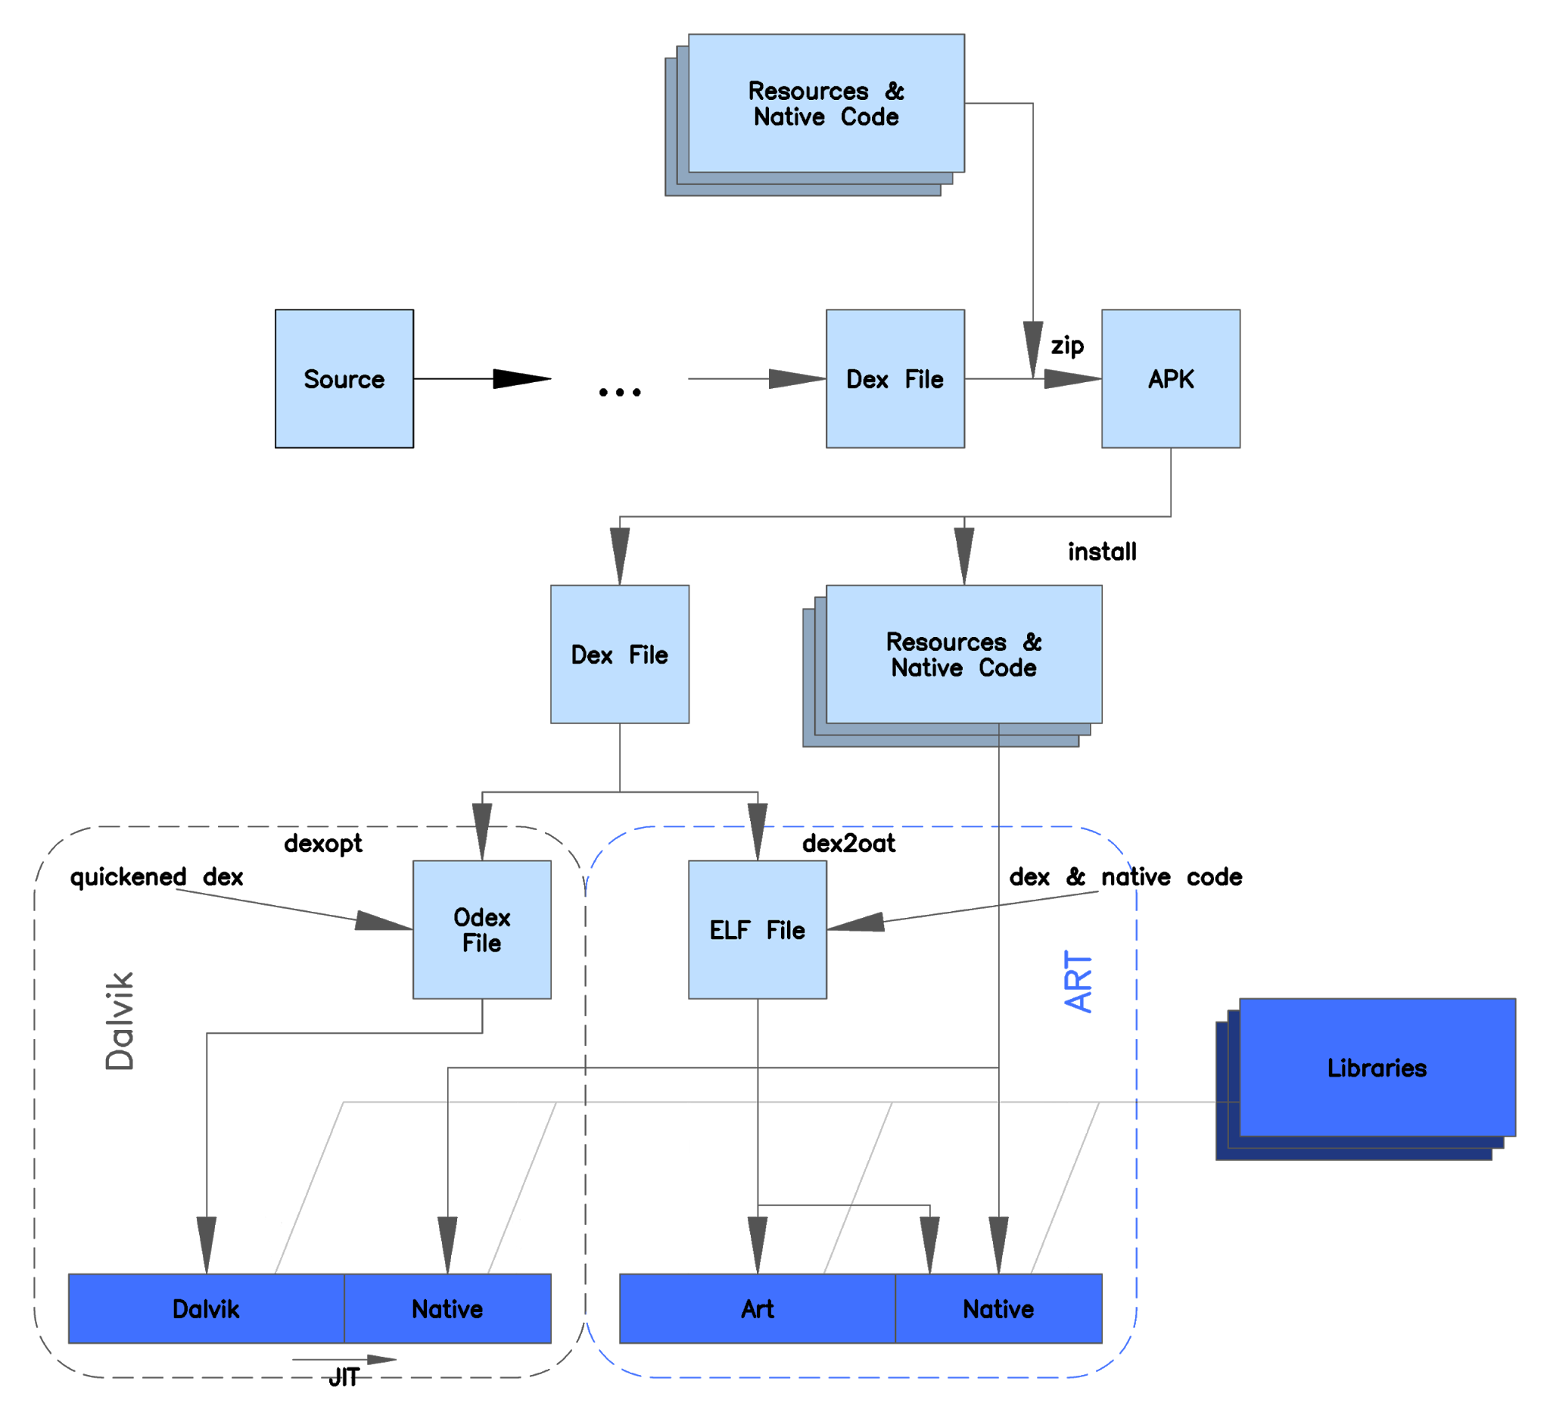
Ahead-of-time Compilation (AOT)
Android 7.0 "Nougat" introduced a JIT compiler with code profiling to ART, which lets it constantly improve the performance of Android apps as they run. The JIT compiler complements ART's current Ahead of Time compiler and helps improve runtime performance

Slide 58
Notes:
Poll Title: Do not modify the notes in this section to avoid tampering with the Poll Everywhere activity. More info at polleverywhere.com/support Questions https://www.polleverywhere.com/discourses/p2pykZB7ifMumvCFR9ys1

