Slide 1
CS474
Object-Oriented Languages and Environments
Spring 2023
Instructor: William Mansky
Lecture 3: Modules, subtyping, overload, override

Slide 2
Notes:
Poll Title: Do not modify the notes in this section to avoid tampering with the Poll Everywhere activity. More info at polleverywhere.com/support Questions https://www.polleverywhere.com/discourses/jvM4Bh4KFn7MtxIjjl5Gn

Slide 3
Object Orientation
Now we know what an object is. What makes a language object-oriented?
It has objects in it
Programming in the language is centered around objects
C++ Java
int main(){ class HelloWorld {
std::cout << “hello world”; public static void main(String[] args){
return 0; System.out.println(“hello world”);
} }
}
Notes:
OO languages are a spectrum – a language can be a little bit OO, or very OO. We’re going to go through features, starting from ones that are in almost every OO language and moving into more specific ones.
In Java, how do you write a program that runs? With objects. How do you print to the command line? With objects.

Slide 4
Object Orientation
Encapsulation
Inheritance / Composition
Overriding / Overloading
Single / Multiple dispatch
Types, casting
Multiple inheritance
Constructors
Access modifiers
More universal
More specific
Notes:
OO languages are a spectrum – a language can be a little bit OO, or very OO. We’re going to go through features, starting from ones that are in almost every OO language and moving into more specific ones.

Slide 5
Encapsulation
struct list {
struct list * next;
void * element;
}
struct list * empty() { return NULL; }
void add(struct list * lst, void * el) { ... }
Is this list implementation well encapsulated?
Notes:
Encapsulation is the idea that each data structure/program component is its own thing – its implementation details aren’t exposed to the rest of the world, and its implementation is separate from any other code we might write.

Slide 6
Encapsulation
struct list {
struct list * next;
void * element;
}
struct list * empty() { return NULL; }
void add(struct list * lst, void * el) { ... }
BigInt add(BigInt i1, BigInt i2) { ... }
Name collisions!

Slide 7
Encapsulation
struct list {
struct list * next;
void * element;
}
struct list * empty() { return NULL; }
void list_add(struct list * lst, void * el) { ... }
BigInt big_int_add(BigInt i1, BigInt i2) { ... }
Name collisions!
Using different names does not really solve the problem…

Slide 8
Encapsulation
struct list {
struct list * next;
void * element;
}
struct list * empty() { return NULL; }
void add(struct list * lst, void * el) { ... }
if (myList == null) // empty list
else print(myList->element);
Lack of abstraction!
We could write getters/setters, but the implementation does not protect the internals

Slide 9
Encapsulation
Encapsulation is the enforcement mechanism for abstraction
Encapsulation separates the contractual interface of an abstraction from its implementation
E.g., interface List vs class LinkedList
Clients can use the interface, but cannot access the implementation (private fields, etc.)

Slide 10
Modules
Group data (variables) and behavior (functions) together while avoiding conflicts with existing similar names
Complex visibility rules
Some elements should be visible from the outside
Other elements must not be visible from the outside
Notes:
Programming language designers have been thinking about encapsulation for a very long time.

Slide 11
Modules as Nested Functions?
int first;
void * list() {
Node first;
void add(int item) { ... }
Node create_new_node() { ... }
}
void * list = list();
Notes:
Here’s something we might do in a language that doesn’t have any kind of module or class system – use scope.
These variables functions aren’t in scope outside of list(), so there’s no way for the client to access them.

Slide 12
Modules as Nested Functions?
Function scope avoids name colisions
int first;
void * list() {
Node first;
void add(int item) { ... }
Node create_new_node() { ... }
}
void * list = list();
Function scope protects access to internal data

Slide 13
Modules as Nested Functions?
Function scope avoids name colisions
int first;
void * list() {
Node first;
void add(int item) { ... }
Node create_new_node() { ... }
}
void * list = list();
Function scope protects access to internal data
Some names should be visible outside the function scope
The module does not live for long enough
Notes:
But we want to be able to call add from outside! And first should still exist, even if we can’t access it.

Slide 14
Modules as Nested Functions?
Function scope avoids name colisions
int first;
void * list() {
Node first;
void add(int item) { ... }
Node create_new_node() { ... }
}
void * list = list();
We need language support for good encapsulation!
Function scope protects access to internal data
Some names should be visible outside the function scope
The module does not live for long enough

Slide 15
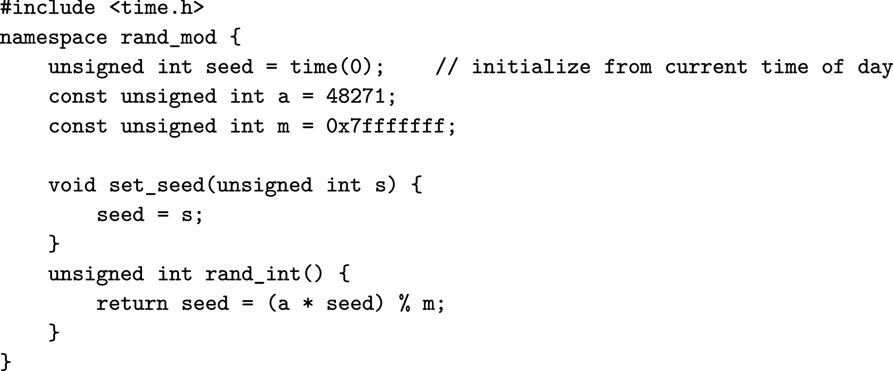
Namespaces as modules
accessed as rand_mod::rand_int()
Notes:
In C++

Slide 16
Namespaces as modules
Module scope avoids name collisions
Module scope protects access to internal data
Some names are visible from outside the module scope
Module scope lives for long enough
How many are true?
a) 0 b) 1 c) 2 d) 3 e) 4
Notes:
d
Anybody who knows the name can still call rand_mod::whatever.

Slide 17
Namespaces as Modules
Static scope
Modules live as long as the program
No name collisions
set_seed can be accessed through rand_mod::set_seed
No problem if there’s another set_seed defined elsewhere
All module internals accessible/visible from outside the module
Only allows one random generator
But we can actually fix that

Slide 18
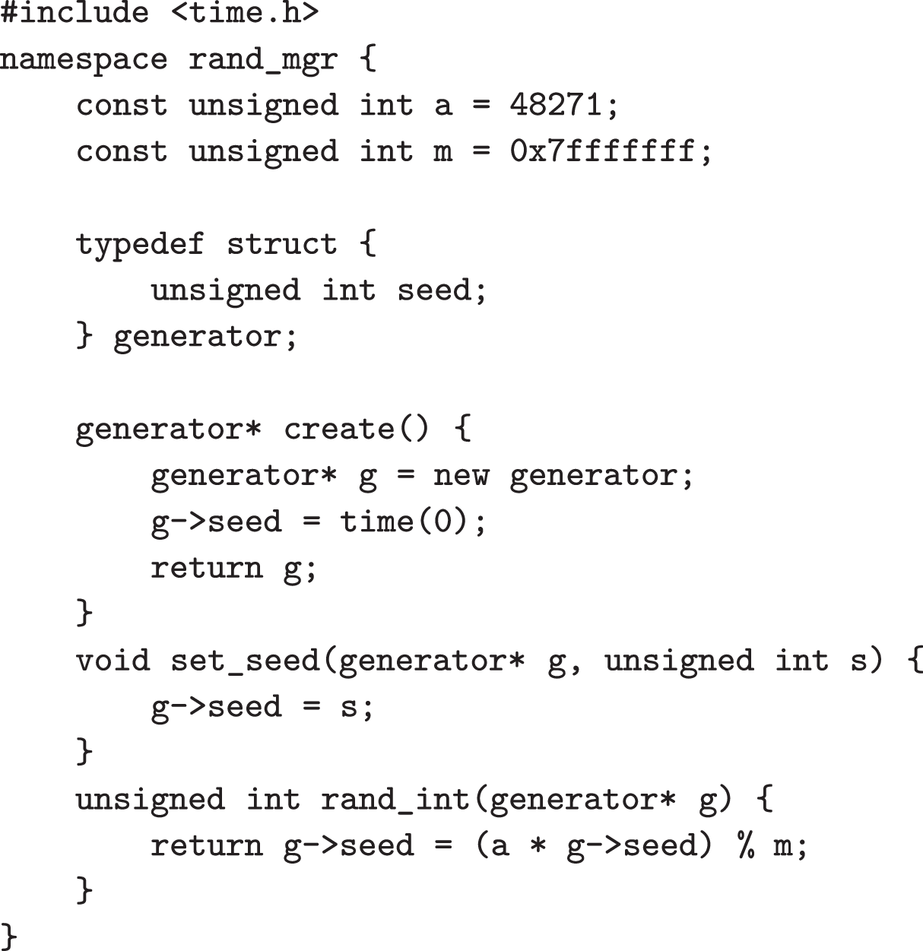
Namespaces as Modules

Slide 19
Namespaces as Modules
Make the state of each generator available to clients
Provide functions to create and manipulate (manage) each generator
Still relies on programmer discipline to not access internal state of the module

Slide 20
Notes:
Poll Title: Do not modify the notes in this section to avoid tampering with the Poll Everywhere activity. More info at polleverywhere.com/support Questions https://www.polleverywhere.com/discourses/jvM4Bh4KFn7MtxIjjl5Gn

Slide 21
Perhaps a Better Syntax?
generator *g = rand_mgr::create();
int r = rand_mgr::rand_int(g);
rand_gen *g = new rand_gen();
int r = g->rand_int();

Slide 22
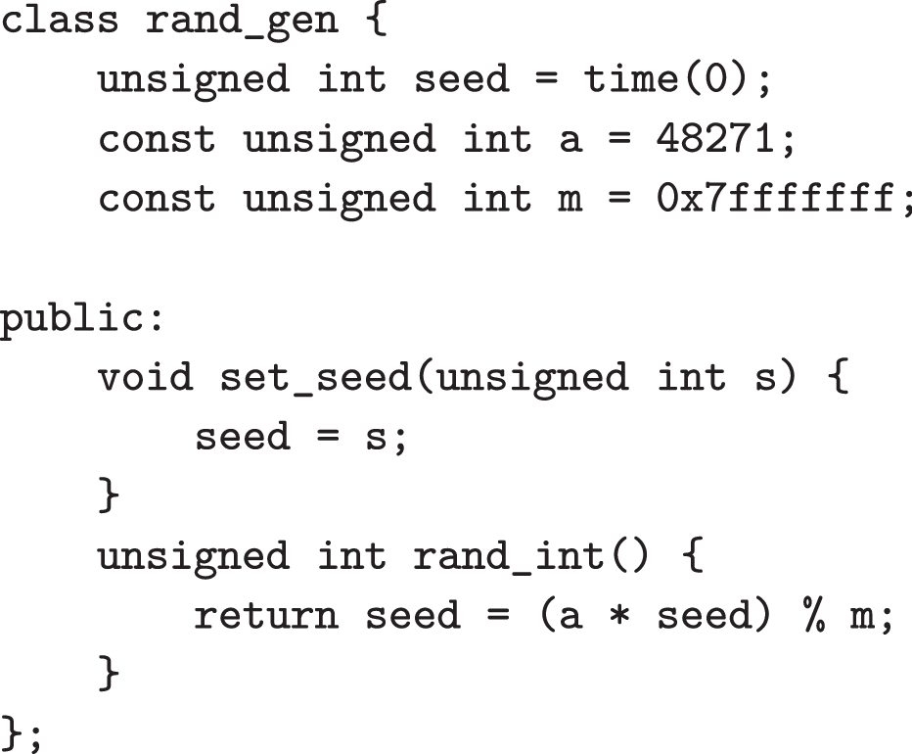
Classes as modules

Slide 23
Classes as modules
Static scope
Avoids name collisions
We can control what to make visible and what to hide
No external access to internal variable seed
Better syntax for clients to use this module
We can even have classes inside modules, which helps with abstraction
Many invisible classes may work behind a visible class

Slide 24
Notes:
Poll Title: Do not modify the notes in this section to avoid tampering with the Poll Everywhere activity. More info at polleverywhere.com/support Questions https://www.polleverywhere.com/discourses/jvM4Bh4KFn7MtxIjjl5Gn

Slide 25
Hierarchy
Simon’s law: Hierarchical structures reduce complexity
Hierarchy is a ranking or ordering of abstractions
In OO languages hierarchy is implemented using inheritance
A class can be derived from one or more superclasses
Languages may support single and/or multiple inheritance

Slide 26
Inheritance
Implement a list that adds elements twice
Without inheritance:
Build a new list from the ground up, 100s of LOC, hard to understand and maintain
With inheritance:
Inheritance is a generalization/specialization hierarchy
public class ListThatAddsStuffTwice extends LinkedList {
public void add(Object o) {
super.add(o);
super.add(o);
}
}

Slide 27
Aggregation
Implement a list with a last-modified timestamp
We cannot really use inheritance here
class TSList extends LinkedList, Timestamp {
// Timestamp is created when the list is created
public void add(Object o) {
super.add(o);
// Timestamps are immutable and cannot be updated
}
public Object remove() {
// Timestamps are immutable and cannot be updated
return super.remove();
}
}
Notes:
This means that TSList *is* a timestamp, so the list gets a timestamp when it is created.

Slide 28
Aggregation
Implement a list with a last-modified timestamp
We cannot really use inheritance here
Instead, use aggregation:
class TSList extends LinkedList {
Timestamp ts = new Timestamp(); // List created
public void add(Object o) {
super.add(o);
ts = new Timestamp();
}
public Object remove() {
ts = new Timestamp();
return super.remove();
}
}

Slide 29
Inheritance and Aggregation
Inheritance expresses “is-a” relationship
A Hawk “is-a” Bird
A Car “is-a” Vehicle
Aggregation expresses “has-a” relationship
A Car “has-a” engine and 4 wheels
A Bicycle “has-a” 2 pedals and 2 wheels
Both cars and bicycles “is-a” vehicles

Slide 30
Notes:
Poll Title: Do not modify the notes in this section to avoid tampering with the Poll Everywhere activity. More info at polleverywhere.com/support Questions https://www.polleverywhere.com/discourses/jvM4Bh4KFn7MtxIjjl5Gn

Slide 31
Single Inheritance
java.lang.Object
Each class has at most one
Superclass is also called parent class
Used in: Java, C#, Ruby
Topmost class has no superclass
java.lang.Object in Java has no superclass
java.util.AbstractCollection
java.util.AbstractList
java.util.Abstract
SequentialList
java.util.Linked
List

Slide 32
Single Inheritance
java.lang.Object
Each class has at most one
Super class is also called parent class
Used in: Java, C#, Ruby
Topmost class has no superclass
java.lang.Object in Java has no superclass
Something that has elements
(e.g., iterator() in any order, add())
java.util.AbstractCollection
Something that provides random access (e.g., get(int position) )
java.util.AbstractList
Sequential access data store
(e.g., iterator has well defined order)
java.util.Abstract
SequentialList
Automatically reuses all the behavior described above
java.util.Linked
List

Slide 33
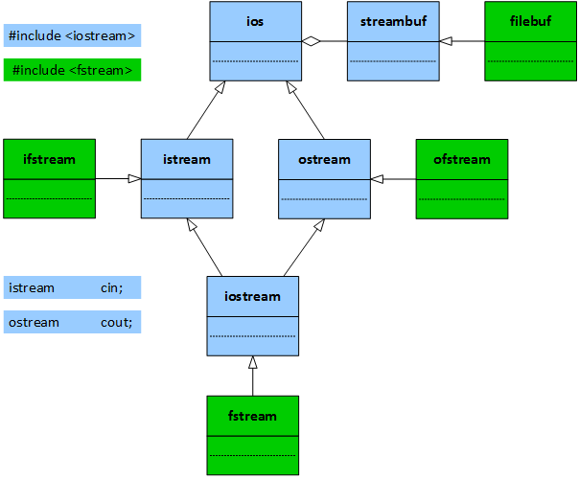
Multiple Inheritance
Each class may have many superclasses
We’ll discuss in more detail later

Slide 34
Notes:
Poll Title: Do not modify the notes in this section to avoid tampering with the Poll Everywhere activity. More info at polleverywhere.com/support Questions https://www.polleverywhere.com/discourses/jvM4Bh4KFn7MtxIjjl5Gn

Slide 35
Object Orientation
Encapsulation
Inheritance / Composition
Overriding / Overloading
Single / Multiple dispatch
Types, casting
Multiple inheritance
Constructors
Access modifiers
Notes:
OO languages are a spectrum – a language can be a little bit OO, or very OO. We’re going to go through features, starting from ones that are in almost every OO language and moving into more specific ones.

Slide 36
Typing
Collection
List
Set
How many work?
0
1
2
3
ArrayList
TreeSet
TreeSet set = new TreeSet();
ArrayList list = new ArrayList();
Collection c = list; // i
Set s = list; // ii
Set s = set; // iii

Slide 37
Typing
The type of an object is the range of values that the object is allowed to take
int : -2³¹; …; -1,0; 1; 2; …; 2³¹
float: 2.33; 3.1415; …
Point: { x = 1, y = 2 }; { x = 5, y = 12 }; …
Types are flexible: we can substitute in subclasses
List: List, LinkedList, ArrayList
Type checking makes sure variables have a consistent type, and operations take operands of appropriate types
If typing is not possible: compiler error

Slide 38
Subtyping
If B is a subtype of A, then an object of B can be used where an object of A is expected
SortedLinkedList is a subtype of LinkedList
An object of SortedLinkedList can be used wherever an object of LinkedList is expected
What is the type of l?
LinkedList
SortedLinkedList
Both
class LinkedList { }
class SortedLinkedList extends LinkedList { }
...
LinkedList l = new SortedLinkedList();
Notes:
In a language with inheritance, class types work a bit differently than types like int or float.

Slide 39
Static vs Dynamic Types
What is the type of list?
Static type: LinkedList
We can use any operation of LinkedList
We cannot use operations only defined in SortedLinkedList
Dynamic type: SortedLinkedList
The implementation of SortedLinkedList will be used at runtime
class LinkedList { }
class SortedLinkedList extends LinkedList { }
...
LinkedList list = new SortedLinkedList();

Slide 40
Subtype Polymorphism
class LinkedList { }
class SortedLinkedList extends LinkedList { }
...
LinkedList l = new SortedLinkedList();
Many shapes (poly: many, morph: shape)
A SortedLinkedList can “take on the shape” of a LinkedList
A reference to a LinkedList could actually contain a SortedLinkedList

Slide 41
Notes:
Poll Title: Do not modify the notes in this section to avoid tampering with the Poll Everywhere activity. More info at polleverywhere.com/support Questions https://www.polleverywhere.com/discourses/jvM4Bh4KFn7MtxIjjl5Gn

Slide 42
Dynamic Dispatch
Student
Student[] roster = new Student[10];
roster[0] = new Undergraduate();
roster[1] = new Graduate();
roster[2] = new Graduate();
roster[3] = new Undergraduate();
...
int sum = 0;
for(Student s : roster)
sum += s.getGrade();
double avg = sum/roster.length;
getGrade()
Undergraduate
Graduate
getGrade()
getGrade()
0
1
2
3
UG
G
UG
G
Notes:
Subtype polymorphism naturally leads into the question of “which method do we call?”

Slide 43
Dynamic Dispatch
int sum = 0;
for(Student s : roster)
sum += s.getGrade();
double avg = sum/roster.length;
s.getGrade() is a polymorphic call
Calls the most specific method, depending on the runtime type of s
The subclasses of Student override the getGrade method with their own implementations

Slide 44
Overriding
class A {
void method() { print("A"); }
}
class B extends A {
void method() { print("B"); }
}
A a = new A();
B b = new B();
A ba = new B();
a.method();
b.method();
ba.method();
What’s printed?
AAA
ABB
ABA
Notes:
Overriding is the thing we do in code that makes dynamic dispatch happen when the program runs.
b

Slide 45
Overriding
Bound at method call time (runtime)
Calls the most specific method
new A().method() -> A
new B().method() -> B
new C().method() -> B
Same call site may call different methods (dynamic dispatch)
class A {
void method() { print("A"); }
}
class B extends A {
void method() { print("B"); }
}
class C extends B { }

Slide 46
Dynamic Dispatch
Student
Student[] roster = new Student[10];
roster[0] = new Undergraduate();
roster[1] = new Graduate();
roster[2] = new Graduate();
roster[3] = new Undergraduate();
...
int sum = 0;
for(Student s : roster)
sum += s.getGrade();
double avg = sum/roster.length;
getGrade()
Undergraduate
Graduate
getGrade()
getGrade()
0
1
2
3
UG
G
UG
G

Slide 47
Notes:
Poll Title: Do not modify the notes in this section to avoid tampering with the Poll Everywhere activity. More info at polleverywhere.com/support Questions https://www.polleverywhere.com/discourses/jvM4Bh4KFn7MtxIjjl5Gn

Slide 48
Overriding
A method has the same signature as another non-private and non-static method in one of the parent classes
Same name
Same return type
Same number of arguments
Same argument types
class A {
void method() { print("A"); }
}
class B extends A {
}
class C extends B {
void method() { print("C"); }
void method(int i) { print("C" + i); }
}
How many overrides?
0
1
2
3
Notes:
In Java, overriding only happens under very specific conditions.
1

Slide 49
Overloading
A method has the same name, but different arguments, than another method on the same class
class A { }
class B extends A { }
class C extends B {
void method(A a) { print("A"); }
void method(B a) { print("B"); }
void method(C a) { print("C"); }
}
A a = new A();
B b = new B();
A ba = new B();
C c = new C();
c.method(a);
c.method(b);
c.method(ba);
How many A’s printed?
0
1
2
3
Notes:
2

Slide 50
Overloading
Bound at compile-time
Compiler decides which method to call, based on the number and type of arguments in a method call
May not be the most specific method possible
class A { }
class B extends A { }
class C extends B {
void method(A a) { print("A"); }
void method(B a) { print("B"); }
void method(C a) { print("C"); }
}
A a = new A();
B b = new B();
A ba = new B();
C c = new C();
c.method(a);
c.method(b);
c.method(ba);
Notes:
2

Slide 51
Overloading
Bound at compile-time
Compiler decides which method to call, based on the number and type of arguments in a method call
May not be the most specific method possible
Equivalent to renaming methods to reflect type and number of args
methodA
methodB
methodC
class A { }
class B extends A { }
class C extends B {
void methodA(A a) { print("A"); }
void methodB(B a) { print("B"); }
void methodC(C a) { print("C"); }
}
A a = new A();
B b = new B();
A ba = new B();
C c = new C();
c.methodA(a);
c.methodB(b);
c.methodA(ba);
Notes:
2

Slide 52
Overloading
Bound at compile-time
Compiler decides which method to call, based on the number and type of arguments in a method call
May not be the most specific method possible
Equivalent to renaming methods to reflect type and number of args
methodA
methodB
methodC
Same call-site always calls the same overloaded method
class A { }
class B extends A { }
class C extends B {
void methodA(A a) { print("A"); }
void methodB(B a) { print("B"); }
void methodC(C a) { print("C"); }
}
A a = new A();
B b = new B();
A ba = new B();
C c = new C();
c.methodA(a);
c.methodB(b);
c.methodA(ba);
Notes:
2

Slide 53
Overriding vs Overloading
class A {
void method(A a) { print("A"); }
}
class B extends A {
void method(B a) { print("B"); }
}
class C extends B {
void method(C a) { print("C"); }
}
Is this method overloaded or overridden?
Overriden
Overloaded
Both
None, this code does not compile
None, this code does not run
Notes:
b

Slide 54
Overriding vs Overloading
class A {
void method(A a) { print("A"); }
}
class B extends A {
void method(B a) { print("B"); }
}
class C extends B {
void method(C a) { print("C"); }
}
Is this method overloaded or overridden?
Overriden
Overloaded
Both
None, this code does not compile
None, this code does not run
An overloaded method has the same name and return, but different arguments, than another method on the same class (including inherited methods)
An overridden method has the same name and signature as another non-private method in one of the parent classes
Notes:
overloaded

Slide 55
Overriding vs Overloading
An overloaded method has the same name and return, but different arguments, than another method on the same class (including inherited methods)
Easier to see overloads if we copy/paste the inherited methods in each class
class A {
void method(A a) { print("A"); }
}
class B extends A {
void method(A a) { print("A"); }
void method(B a) { print("B"); }
}
class C extends B {
void method(A a) { print("A"); }
void method(B a) { print("B"); }
void method(C a) { print("C"); }
}
Notes:
overloaded

Slide 56
Overriding vs Overloading
An overloaded method has the same name and return, but different arguments, than another method on the same class (including inherited methods)
Easier to see overloads if we copy/paste the inherited methods in each class
Copy/paste overrides does not make sense because all methods have the same name and signature
class A {
void method() { print("A"); }
}
class B extends A {
void method() { print("A"); }
void method() { print("B"); }
}
class C extends B {
void method() { print("A"); }
void method() { print("B"); }
void method() { print("C"); }
}
Notes:
overloaded

Slide 57
Overriding vs Overloading
class A {
void method() { print("A"); }
}
class B extends A {
void method() { print("B"); }
}
class C extends B { }
class A { }
class B extends A { }
class C extends B {
void method(A a) { print("A"); }
void method(B a) { print("B"); }
void methodC(C a) { print("C"); }
}
Notes:
Highlight differences in how they are declared

Slide 58
Overriding vs Overloading
class A {
void method() { print("A"); }
}
class B extends A {
void method() { print("B"); }
}
class C extends B { }
A a = new A();
B b = new B();
A ba = new B();
a.method();
b.method();
ba.method();
class A { }
class B extends A { }
class C extends B {
void method(A a) { print("A"); }
void method(B a) { print("B"); }
void methodC(C a) { print("C"); }
}
A a = new A();
B b = new B();
A ba = new B();
C c = new C();
c.method(a);
c.method(b);
c.method(ba);
Notes:
Highlight differences in how they behave

Slide 59
Overriding vs Overloading
 | Overriding | Overloading
Same name as method in | Any parent class | Same class (including inherited methods)
Arguments | Same arguments | Different arguments
Method called | Depends on receiver type | Does not depend on argument type
Binding time | Call time (runtime) | Compile time
Notes:
Highlight differences in how they behave

Slide 60
Notes:
Poll Title: Do not modify the notes in this section to avoid tampering with the Poll Everywhere activity. More info at polleverywhere.com/support Questions https://www.polleverywhere.com/discourses/jvM4Bh4KFn7MtxIjjl5Gn

Slide 61
Overriding AND Overloading?
class A {
void method() { print("A"); }
}
class B extends A {
void method() { print("B"); }
}
class C extends B { }
A a = new A();
B b = new B();
A ba = new B();
a.method();
b.method();
ba.method();
class A { }
class B extends A { }
class C extends B {
void method(A a) { print("A"); }
void method(B a) { print("B"); }
void method(C a) { print("C"); }
}
A a = new A();
B b = new B();
A ba = new B();
C c = new C();
c.method(a);
c.method(b);
c.method(ba);
Is it possible to override and overload the same method?
Yes
No
Notes:
a

Slide 62
Overriding AND Overloading
class A {
void method() { print("A"); }
}
class B extends A {
void method() { print("B"); }
}
class C extends B {
void method() { print("C"); }
void method(A a) { print("cA"); }
void method(B a) { print("cB"); }
}
A a = new A();
B b = new B();
A ba = new B();
C c = new C();
a.method();
b.method();
ba.method();
c.method();
c.method(a);
c.method(b);
c.method(ba);
What does the last call print?
cA
cB

Slide 63
Notes:
Poll Title: Do not modify the notes in this section to avoid tampering with the Poll Everywhere activity. More info at polleverywhere.com/support Questions https://www.polleverywhere.com/discourses/jvM4Bh4KFn7MtxIjjl5Gn

