Slide 1
CS474
Object-Oriented Languages and Environments
Spring 2023
Instructor: William Mansky
Lecture 0: Introduction

Slide 2
Welcome!
Notes:
I’m really happy that you decided to take this class with me!

Slide 3
Introduction
Professor: William Mansky (he/him) (mansky1@uic.edu)
I teach PL design (476), compilers (473), verification (494)
I’m interested in language design decisions and their implications!
TA: Chao Ding (he/him)
Meets Tuesday/Thursday 12:30-1:45 in TBH 180G
Drawing heavily on previous iterations by Prof. Luís Pina
This is my first time teaching 474, so please let me know what works and what doesn’t!
Stop and ask questions anytime
Website: https://cs474-uic.github.io/cs474-spring2023-site/
Anonymous in-class questions: https://pollev.com/wmansky771
Lectures online via Blackboard Collaborate
In-class exercises on Gradescope (course code E7XV86)
Discussion board on Piazza, assignments via GitHub

Slide 4
Asking questions
In class: raise your hand anytime
You can ask questions anonymously with PollEverywhere (https://pollev.com/wmansky771)
On Piazza
Can ask/answer anonymously
Can post privately to instructors
Can answer other students’ questions
In office hours
If you have a question, someone else probably has the same question!
Notes:
Stop for questions!

Slide 5
Notes:
Poll Title: Do not modify the notes in this section to avoid tampering with the Poll Everywhere activity. More info at polleverywhere.com/support Questions https://www.polleverywhere.com/discourses/jvM4Bh4KFn7MtxIjjl5Gn

Slide 6
Object-Oriented Langs and Envs
Object-Oriented​
Programming style where data and code are bundled together in objects
(Programming) Languages​
A vocabulary and set of rules for instructing a computer to perform a task​
E.g. Java, C++​
Environments​
Languages do not exist in isolation; they need a set of tools to work​
E.g. build system (ant, makefile), compiler (clang, gcc), IDE (eclipse)​
Goal: Understand what it means for a language to be OO, how it helps, what the choices are, how it affects the way we program
Notes:
Focus on the plural
What do we need to communicate here?
Poll on what languages people have used, which they think are OO?

Slide 7
Job Ad
Salary >$100,000/yr
Senior Software Engineer - Multi-Device Experience
Address complex architectural problems with simple, intuitive design
Interest in trying new things and switching between projects as needed
Experience with Java or Objective-C/Swift, and Javascript
Mobile development, mobile test automation, Typescript, and Node.js
…
Notes:
Highlight different languages
We’re going to try to understand the commonalities and differences between these languages, and why they work the way they do.

Slide 8
Example Final Question
class C {
void m(Object o) { print(1); } }
class D extends C {
void m(Object o) { print(2); }
void m(String s) { print(3); } }
C d = new D();
Object o = new String("CS474");
d.m(o);
Result in Java?
1
2
3
Runtime error
Compilation error
Notes:
What do I mean by choices?
Put ??? next to each of the definitions – is it a C, or a D? An Object, or a String?
2 in Java, option b

Slide 9
Example Final Question
class C {
void m(Object o) { print(1); } }
class D extends C {
void m(Object o) { print(2); }
void m(String s) { print(3); } }
C d = new D();
Object o = new String("CS474");
d.m(o);
Result in C++?
1
2
3
Runtime error
Compilation error
Notes:
1

Slide 10
Example Final Question
class C {
void m(Object o) { print(1); } }
class D extends C {
void m(Object o) { print(2); }
void m(String s) { print(3); } }
C d = new D();
Object o = new String("CS474");
d.m(o);
Result in JavaScript?
1
2
3
Runtime error
Compilation error
Notes:
3
We’re going to learn not just how to figure out the answer, but why we might make all these different choices.

Slide 11
Overview of Topics
Language design
Fundamentals
Binding, scope, environments, nesting
OO
Abstraction, objects, inheritance, typing, dispatch, reflection, error handling
Functional programming
Expressions vs. statements, pure functions, recursion, higher-order functions, stream API
Language implementation
Program interpretation
Fundamentals, functional vs. imperative, direct vs. continuation style, callbacks
OO language implementation
Bytecode execution, JVM object model, garbage collection, JIT compilation

Slide 12
Notes:
Poll Title: Do not modify the notes in this section to avoid tampering with the Poll Everywhere activity. More info at polleverywhere.com/support Questions https://www.polleverywhere.com/discourses/jvM4Bh4KFn7MtxIjjl5Gn

Slide 13
Grading
Attendance: 20%
Programming Assignments: 50%
Midterm: 15%
Final: 15%
Participation: up to 5% bonus

Slide 14
Attendance
You can get points for attendance using one of two ways:
In person and online synchronous
Attend the lecture live Tuesdays and Thursdays
In-person and streaming on BB Collaborate
Do in-class exercises on Gradescope to get attendance credit
Correctness does not count: Wrong answers still get you full credit!

Slide 15
Attendance
You can get points for attendance using one of two ways:
Asynchronous
Watch the lecture offline within 1 week
Submit the in-class exercise on Gradescope
Must get the answers correct to count
Attend 80% of classes for full marks
You can miss 5 classes
You can attend each lecture synchronously or asynchronously as needed (but come in person when you can – you’ll learn more!)

Slide 16
Notes:
Poll Title: Do not modify the notes in this section to avoid tampering with the Poll Everywhere activity. More info at polleverywhere.com/support Questions https://www.polleverywhere.com/discourses/jvM4Bh4KFn7MtxIjjl5Gn

Slide 17
Prerequisites
How familiar with Java are you?
Never heard of Java
I have heard of Java but never used it
I used Java on a personal project
I took a class at UIC that used Java
I interned at a company that used Java
Notes:
I’m assuming d, but c may also be enough

Slide 18
Prerequisites
CS342 (Software Design) with C or better
Or equivalent for other universities
Basic understanding of software development
Compilation, linking, debugging, etc.
Comfortable writing code regularly
50% of your grade is based on code submissions!

Slide 19
Class Website
https://cs474-uic.github.io/cs474-spring2023-site/
Notes:
Syllabus, schedule, lecture slides, assignment links, etc.

Slide 20
Assignments
5 assignments in Java worth 10% each = 50%
Assignments are autograded with 10 tests, each worth 10%
We’ll release all the tests with the assignments
But we take hard-coding very seriously
You get your grade after each submission
Some assignments require you to submit a screen-cast video
Explain me your code in 5 min or less
All assignments for graduate students
Some assignments require you to answer written questions about your code

Slide 21
Assignment Release
Every other week there’s an assignment due
One week: Assignment is out
Next week: Assignment is due
Break around midterm
Assignment | Released Week | Due Week | Due Date
A0 | 1 | 2 | 01/21
A1 | 2 | 4 | 02/04
A2 | 5 | 6 | 02/18
Midterm | 8 | 02/28
A3 | 8 | 9 | 03/11
A4 | 10 | 11 | 04/01
A5 | 12 | 14 | 04/22

Slide 22
Assignment Submission
Written in Java unless otherwise specified
Submitted through GitHub
You have to accept the GitHub Classroom invitation
You get a private repository for your code
The last commit before the deadline is your submission
Recommended editor: IntelliJ IDEA
Automatic grader on GitHub
Runs for each push
You can check your grade at any point
Set-up video for Assignment 0 walks through the process
You must finish Assignment 0 to ensure you understand everything

Slide 23
Register your GitHub account
Please register your GitHub account name using the following link: https://forms.gle/PP2W9g7PRGH7714P8
Notes:
Fix link

Slide 24
Assignment 0
Goal: Understand how to:
Start an assignment
Work on an assignment
Submit an assignment
Check your grade
Trivial Java code
Different for each student
You have to check the autograder to figure out your solution
Accept assignment at: https://classroom.github.com/a/I0mpxzds
Follow instructions on the Assignment 0 intro video
You must submit Assignment 0 to receive any grade
// Each student has their own code System.out.println("987123817");
Notes:
Show the assignment

Slide 25
Assignment Due Date and Late Policy
Assignments are due on Saturday at 5PM
You still have most of your weekend
No late submissions
Your submission is the latest commit in your GitHub repo before the deadline
If circumstances beyond your control will prevent you from submitting on time, please let me know as soon as possible!

Slide 26
Assignment Resubmission
Assignments can be resubmitted for one week after the due date
We will go over the outline of the solution in class, and you can ask for more help in office hours/on Piazza
You have until the next Saturday at 5PM to resubmit
Final assignment grade
Average between the original grade and the resubmission grade
Restrictions
Must include a text file explaining what you changed
Notes:
No resubmission for graduate students

Slide 27
Academic Integrity
How many are OK?
I wrote pseudo-code together with a colleague that we then implemented separately
Someone sent me their implementation of (i) before I finished mine and I used it
I worked with a friend just to get the assignment started, then we went our separate ways
I got someone to write code for me
Notes:
Post it on Piazza
No
Post it on Piazza
Very much no

Slide 28
Academic Integrity
You have to write all the code you turn in
You can discuss how to implement the assignments with your colleagues
You can post questions and answers that involve code on Piazza
E.g., how to use a particular API
If you need to post a large code fragment, make it private
More details in the syllabus

Slide 29
Assignment Plagiarism
if (a == 1) b = 2;
if (x != 1) { // empty }
else { y = 2; }

Slide 30
Assignment Plagiarism
if
==
=
a
1
b
2
if (a == 1) b = 2;
if (x != 1) { // empty }
else { y = 2; }

Slide 31
Assignment Plagiarism
if
if
==
=
==
=
a
1
b
2
x
1
y
2
if (a == 1) b = 2;
if (x != 1) { // empty }
else { y = 2; }

Slide 32
Assignment Plagiarism
(hundreds more pair-wise comparisons below)

Slide 33
Assignment Plagiarism
Notes:
prevBool = previousVal
outConstructorToCall = newConst

Slide 34
Assignment Plagiarism
Zero grade on the assignment
One letter drop in the final grade
E.g., B to C or D to F
Not sure? Struggling? Ask on Piazza!
Extra credit if you do so!

Slide 35
Assignment Plagiarism
Good reasons to not
Office hours
Piazza (you get bonus for asking questions!)
Resubmission possible
You can improve a low grade by A LOT
Original submission 30%, resubmission 100% = 65% (more than 2x improvement)
Original submission 50%, resubmission 100% = 75%
Original submission 80%, resubmission 100% = 90%
Notes:
You shouldn’t need to!

Slide 36
Notes:
Poll Title: Do not modify the notes in this section to avoid tampering with the Poll Everywhere activity. More info at polleverywhere.com/support Questions https://www.polleverywhere.com/discourses/jvM4Bh4KFn7MtxIjjl5Gn

Slide 37
Exams
Midterm exam: 15%
Around Feb 28
During class
Final exam: 15%
TBD (the university tells me when)
Exams are in person
Everybody takes it at the same time

Slide 38
Reading
Required textbooks
Michael L. Scott, Programming Language Pragmatics, Fourth Edition, Morgan Kaufmann, 2016
No book is required to buy
Older version available online via the library (not much changed)
PDFs are available online
Papers and Slide Handouts
available on the course website

Slide 39
Announcements
All announcements will be posted on Piazza
No announcements on Blackboard
No announcements via email (but Piazza should send you emails)

Slide 40
Office Hours
On BB Collab
Same as online lectures
In person
Professor: 10-11 Monday, 2-3 Thursday
In-person office: SEO 1331 (have to take the stairs from 12 to 13)
TA: 2-3 Tuesday, 3-4 Wednesday
In-person office: TBD
Can you make it to office hours?
Yes for all
Yes for one
Yes for two
No for all
Notes:
No TA office hours this week, but I’ll hold my Thursday office hour.

Slide 41
COVID-19
I understand you may lose days
Personal and family related issues due to the pandemic
Finding a job in the current market
You can skip 5 lectures and still get full attendance
You can follow lectures through the recording
Assignment resubmission policy
In-person exams
2 days in the whole semester that you do have to be available
Remote students in different timezones: Please message me on Piazza
Students with special accommodations: Please message me on Piazza

Slide 42
COVID-19
The whole semester will look the same
Get used to the first couple of weeks
Everything will be very similar to those weeks
“Minimize surprises”
We can adjust things that don’t work
I’m always open for feedback
If something is fundamentally not working, we’ll change it
Curving at the end will help fix things

Slide 43
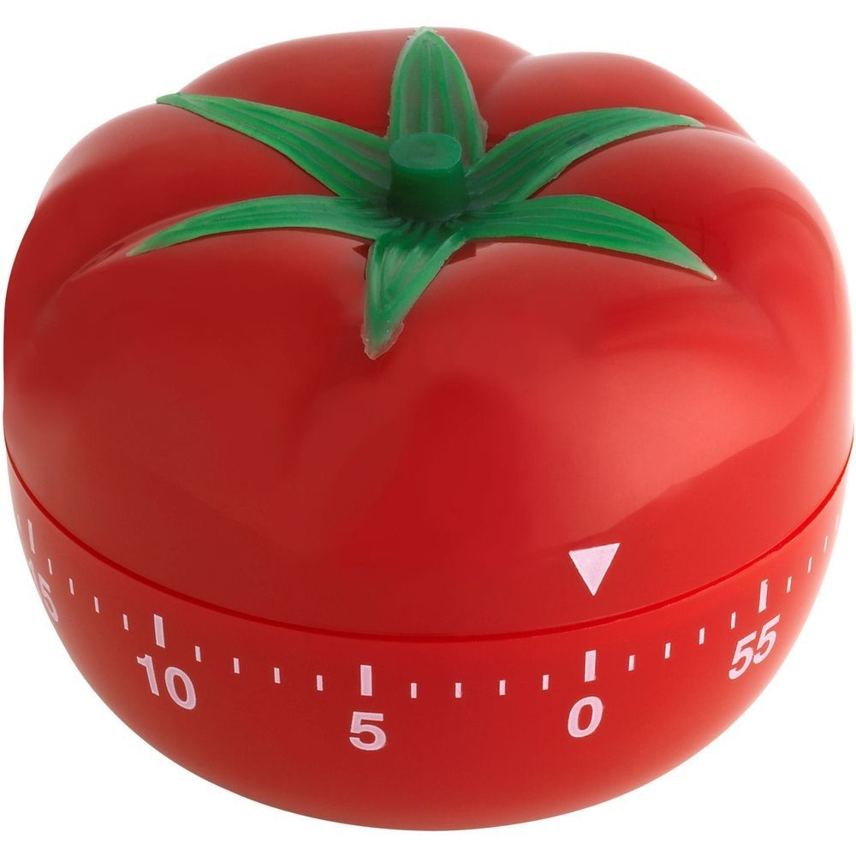
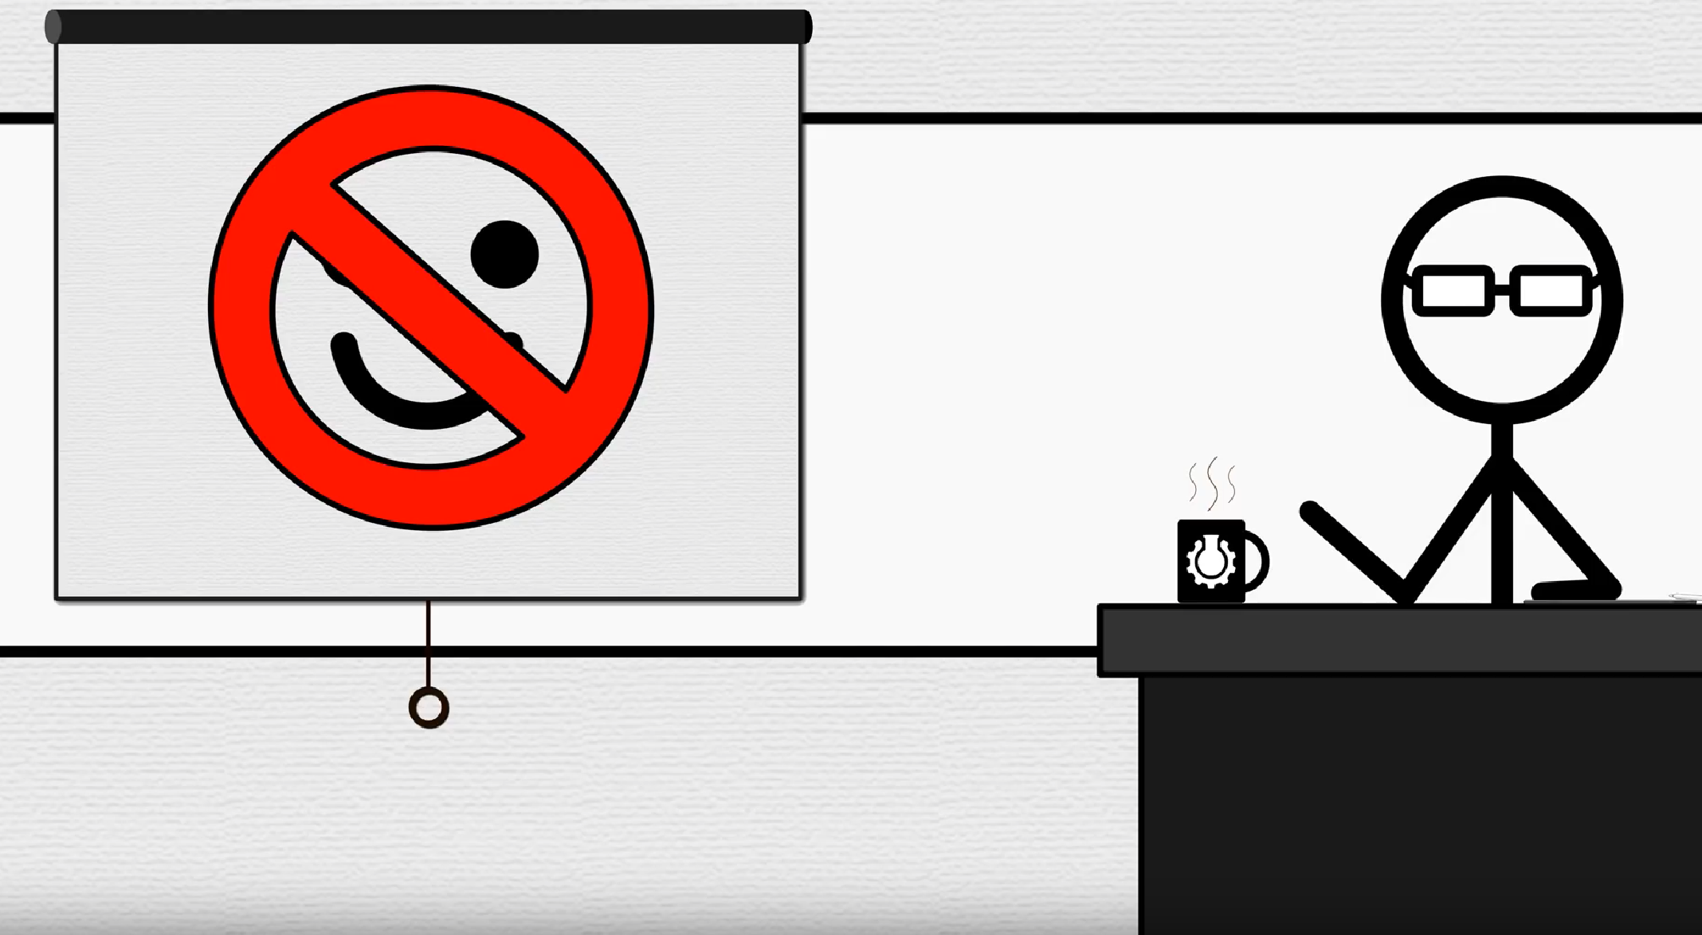
Self-Care
Sleep, eat, exercise
Take time off work
“Pomodoro technique” to focus on tasks
https://en.wikipedia.org/wiki/Pomodoro_Technique
“Getting things done” for time management
https://en.wikipedia.org/wiki/Getting_Things_Done
7 ways to maximize misery
https://www.youtube.com/watch?v=LO1mTELoj6o
Book “How to Be Miserable: 40 Strategies You Already Use” by Paterson PhD, Randy J.

Slide 44
Resources
Wellness center:
https://wellnesscenter.uic.edu/resources-and-services/
Free food pantry
Free wellness supplies
Stress relief
Homelessness, addiction help
UIC Counseling Center:
https://counseling.uic.edu/
Notes:
Click through the links

Slide 45
Important Dates
January 20 – Friday
Last day to complete late registration; last day to add a course(s) or make section changes; last day to drop individual courses via XE Registration without receiving W (Withdrawn) grade on academic record
Feb 28 – Tuesday
Midterm exam
March 20-24
Spring break, no class
April 27 – Thursday
Last day of class
May 1-5
Final examinations
May 10
Final grading deadline

Slide 46
Netiquette
Use professional language. Always say please and thank you and leave text messaging abbreviations out of messages and posts. Be positive and constructive in your feedback to replies to students.
Try not to use all caps--it comes across as shouting to the reader. Use "bold" formatting or use quotes to emphasize a word or phrase. It may be okay at times for headings or to place emphasis on a web page, but try to avoid it when communicating on discussion boards or corresponding with others electronically.
User proper language and titles – no slang or profanity. Even if a word is one you consider to be "not so bad," it could be offensive to others.
Review posts and messages before saving. Check for grammar and spelling errors and restate your message when necessary.
Ask for clarification. If you do not understand an assignment or feedback from me, please ask for clarification. I will do my best to word my posts/messages as clearly as possible, but in an online environment, I cannot "see" if my messages are being understood.
Consider turning on your camera/microphone on interactions with the instructors. You are encouraged to turn on your camera and microphone during live lectures, and even more so during interactions with the instructor during office hours. The instructors will always have their camera and microphone on.

Slide 47
Notes:
Poll Title: Do not modify the notes in this section to avoid tampering with the Poll Everywhere activity. More info at polleverywhere.com/support Questions https://www.polleverywhere.com/discourses/jvM4Bh4KFn7MtxIjjl5Gn

Slide 48
Tasks
Thursday
Before Thursday
Check access to Piazza
Check access to Gradescope
Register on GitHub and fill form at https://forms.gle/PP2W9g7PRGH7714P8
Saturday 01/21
One week from this Saturday
Turn in Assignment 0
Notes:
Check time, take a break

